Slide 1
Python for Machine Learning (ML)
Nadia Udler
Lecture 1
Spring 2023

Slide 2
In this lecture
Recommended book, links and tutorials
Introduction and background topics (linear algebra, calculus, optimization, probability and statistics,)
Data representation for machine learning methods
Supervised and unsupervised methods
Regression and Classification
Linear models
Representing uncertainty
Estimating quality of ML methods

Slide 3
Key topics, Goals, Prerequisites, Software
Key Topics:
- History of ML
- ML concepts and terminology
Scikit-Learn, Scipy, Tensorflow and other ML software libraries
Software:
Anaconda (includes Scikit-learn ans Scipy)
https://www.anaconda.com/products/individual
Tensorflow – run the following command from Anaconda prompt:
Pip install tensorflow
Goals:
- Use ML software libraries for data analysis and decision making
- Read books and papers related to ML
Prerequisites:
- basic knowledge of Python
- high school math

Slide 4
History of ML
ML methods – some definitions:
Algorithms that mimic human learning process
(humans analyze huge amount of information in order to come up with everyday decisions such as making decisions at the shopping center or making decisions during a walk in the unknown city)
Using data to improve decisions
Many currently used ML algorithms were developed 60-70 years ago but were not viable alternative to other methods (say, approximation methods) because computers were too slow.
Revival of ML is due to increased computer efficiency.
Data-driven process instead of model-driven process.
Earlier ML courses were focused on methods: Linear Regression, Logistic Regression, Neural Networks, Decision Trees, Bayesian Inference, K-means clustering
See Andrew Ng Machine Learning course on Coursera, Stanford University
Most recent ML courses are focused on general concepts that underly many ML methods
See Christopher Manning course at Stanford University

Slide 5
ML concepts
Supervised Learning
Unsupervised Learning
Reinforcement Learning
Deep Learning
Logistic Regression
Linear Support Vector Machines, Kernel Support Vector Machines
Neural Networks
Perceptron, Kernel Perceptron
Recurrent Neural Networks
Convolutional Neural Networks
Bayesian inference
Automatic Differentiation

Slide 6
ML concepts
Supervised learning
Learn from examples, given example data (x,y) learn to recognize y given x for new samples
Unsupervised learning
data is not labeled. Find structure in the data
Reinforcement Learning
Learn to recognize y given x when sample data is not given, learn from experience, label data according to your experience

Slide 7
Approaches to study ML
By individual methods – Support Vector Machines, Neural Networks, K-means clustering
Logistic Regression
By required math background – linear models in ml, kernel methods in mL, simulations in ML, Maximum Likelihood estimation in ML
By area of application – ML for text processing, ML for bioengineering,
ML for speech recognition, ML for image recognition, ML for finance

Slide 8
Machine Learning(ML) Course Roadmap
Mathematics
Line equation
Solving systems of linear equations
Solving systems of linear inequalities
Linear models
Method of least squares
Computing derivatives
Generating random numbers
Bayes Theorem
Probabilistic modeling
Maximum Likelihood estimation
Least Squares
Maximum A Posterior estimation
Exponent, logarithm, Logit function, sigmoid function
Partial differential equations
Applications
Classification vs regression
Linear Regression
Logistic Regression
Feed Forward Neural Networks
K-means clustering
Mathematics
Lines, Planes, Normal Vectors
Liner Programming, Primal and Dual programs
Applications
Linear Support Vector Machine
Support Vector Machines with Kernel
Convolutional Neural Networks for image recognition
Linguistics
Fuzzy sets, linguistic variables, fuzzy logic
Natural Language Processing applications
Tools
Python, Scipy, Numpy, Matplotlib,
Scikit-learn, Keras, Tensorflow, SymPy, AlgoPy

Slide 9
Books and Links
Mathematics for machine learning
https://mml-book.github.io/book/mml-book.pdf
Machine Learning in Finance
https://www.google.com/books/edition/Machine_Learning_in_Finance/0pruDwAAQBAJ?hl=en&gbpv=1&printsec=frontcover
Introduction to Computation and Programming Using Python, second edition: With Application to Understanding Data
https://www.amazon.com/Introduction-Computation-Programming-Using-Python/dp/0262529629/ref=mp_s_a_1_1?dchild=1&keywords=john+guttag&qid=1603489306&sr=8-1
Clever Algorithms
https://doc.lagout.org/science/0_Computer%20Science/2_Algorithms/Clever%20Algorithms_%20Nature-Inspired%20Programming%20Recipes%20%5BBrownlee%202012-06-15%5D.pdf
Perceptron algorithm tutorial
https://towardsdatascience.com/perceptron-learning-algorithm-d5db0deab975
Machine learning Financial Laboratory
https://mlfinlab.readthedocs.io/en/latest/
Master Machine Learning
https://www.coursera.org/learn/machine-learning?utm_source=gg&utm_medium=sem&utm_campaign=07-StanfordML-US&utm_content=07-StanfordML-US&campaignid=685340575&adgroupid=52515609594&device=c&keyword=machine%20learning%20mooc&matchtype=b&network=g&devicemodel=&adpostion=&creativeid=273169971757&hide_mobile_promo&gclid=Cj0KCQjw28T8BRDbARIsAEOMBczNPikPt41GFHtlqwNjXj3mLlNKk1TMugMKSlYHc53jefgBgKwcfJIaAu1iEALw_wcB
Natural Language Processing by Christopher Manning
https://www.youtube.com/watch?v=5qf_MZX0YCw
OpenML course
Open Machine Learning Course mlcourse.ai • mlcourse.ai

Slide 10
Recommended tutorials
Pandas beginner tutorial
10 minutes to pandas — pandas 1.3.0 documentation (pydata.org)
Numpy beginner tutorial
NumPy quickstart — NumPy v1.21 Manual
Scikit-learn tutorials
An introduction to machine learning with scikit-learn — scikit-learn 0.24.2 documentation
scikit-learn Tutorials — scikit-learn 0.24.2 documentation
Scikit-learn unsupervised learning
Unsupervised learning: seeking representations of the data — scikit-learn 0.24.2 documentation
2. Unsupervised learning — scikit-learn 0.24.2 documentation
2.3. Clustering — scikit-learn 0.24.2 documentation
sklearn.cluster.KMeans — scikit-learn 0.24.2 documentation
10 Clustering Algorithms With Python (machinelearningmastery.com) – by Jason Brownlee, author of ‘Clever algorithms’
PREDICTING IRIS FLOWER SPECIES WITH K-MEANS CLUSTERING IN PYTHON | by Belen Sanchez | Medium
A demo of K-Means clustering on the handwritten digits data — scikit-learn 0.24.2 documentation
Tensorflow unsupervised learning
https://towardsdatascience.com/unsupervised-machine-learning-example-in-keras-8c8bf9e63ee0
Text Classification
Introduction | Text classification guide | Google Developers

Slide 11
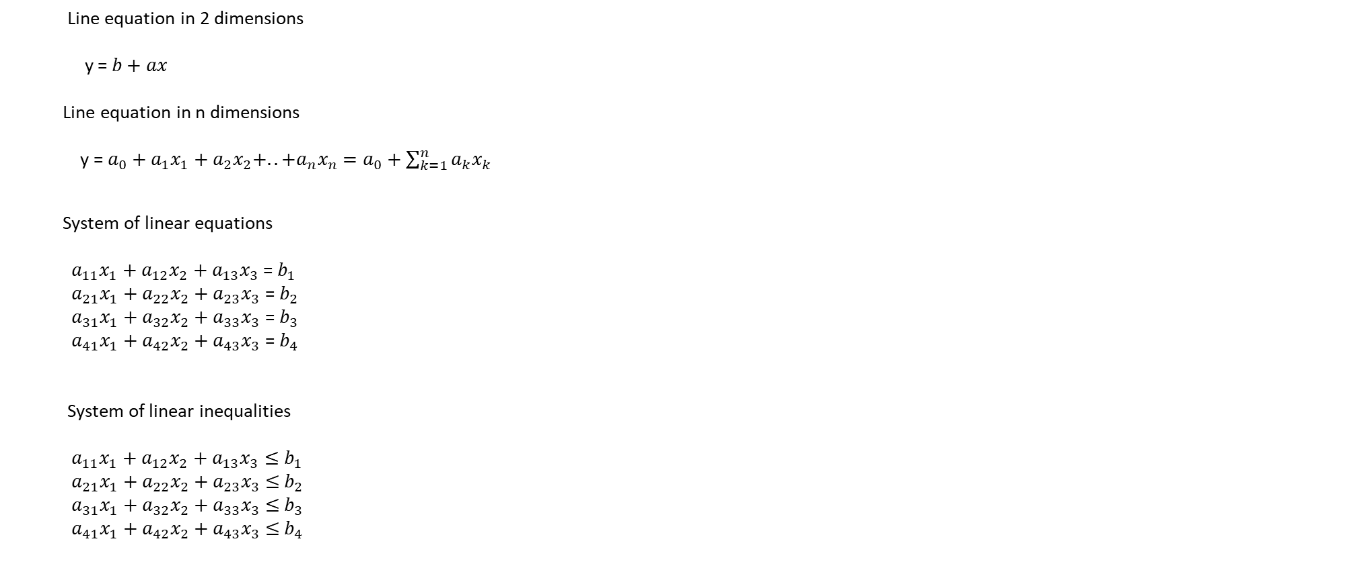
Mathematics of ML: Line equation
Line equation in 2 dimensions
y =$b+ax$
Line equation in n dimensions
y = $a_{0}+a_{1}x_{1}+a_{2}x_{2}+..+a_{n}x_{n}$ $=a_{0}+\sum_{k=1}^{n}{a_{k}x_{k}}$
System of linear equations
$a_{11}x_{1}+a_{12}x_{2}+a_{13}x_{3}$= $b_{1}$
$a_{21}x_{1}+a_{22}x_{2}+a_{23}x_{3}$ = $b_{2}$
$a_{31}x_{1}+a_{32}x_{2}+a_{33}x_{3}$ = $b_{3}$
$a_{41}x_{1}+a_{42}x_{2}+a_{43}x_{3}$ = $b_{4}$
System of linear inequalities
$a_{11}x_{1}+a_{12}x_{2}+a_{13}x_{3}≤$ $b_{1}$
$a_{21}x_{1}+a_{22}x_{2}+a_{23}x_{3}$ $≤$ $b_{2}$
$a_{31}x_{1}+a_{32}x_{2}+a_{33}x_{3}$ $≤$ $b_{3}$
$a_{41}x_{1}+a_{42}x_{2}+a_{43}x_{3}$ $≤$ $b_{4}$

Slide 12
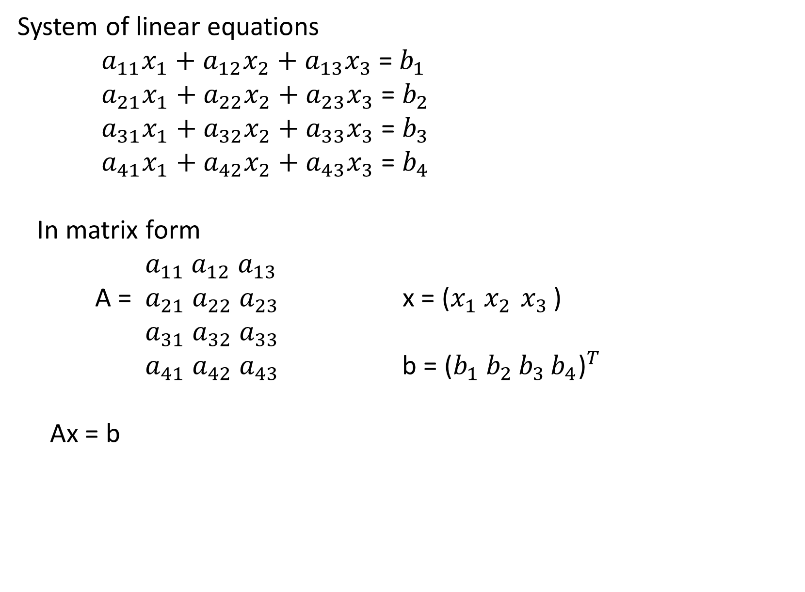
Mathematics of ML: system of linear equations
System of linear equations
$a_{11}x_{1}+a_{12}x_{2}+a_{13}x_{3}$= $b_{1}$
$a_{21}x_{1}+a_{22}x_{2}+a_{23}x_{3}$ = $b_{2}$
$a_{31}x_{1}+a_{32}x_{2}+a_{33}x_{3}$ = $b_{3}$
$a_{41}x_{1}+a_{42}x_{2}+a_{43}x_{3}$ = $b_{4}$
In matrix form
${ a}_{11} a_{12} a_{13}$
A = $a_{21} a_{22} a_{23}$ x = ($x_{1}$ $x_{2 }x_{3 }$)
${ a}_{31} a_{32} a_{33}$
${ a}_{41} a_{42} a_{43}$ b = ${\text{(}b_{1} b_{2 }b_{3 }b_{4}\text{)}}^{T}$
Ax = b

Slide 13
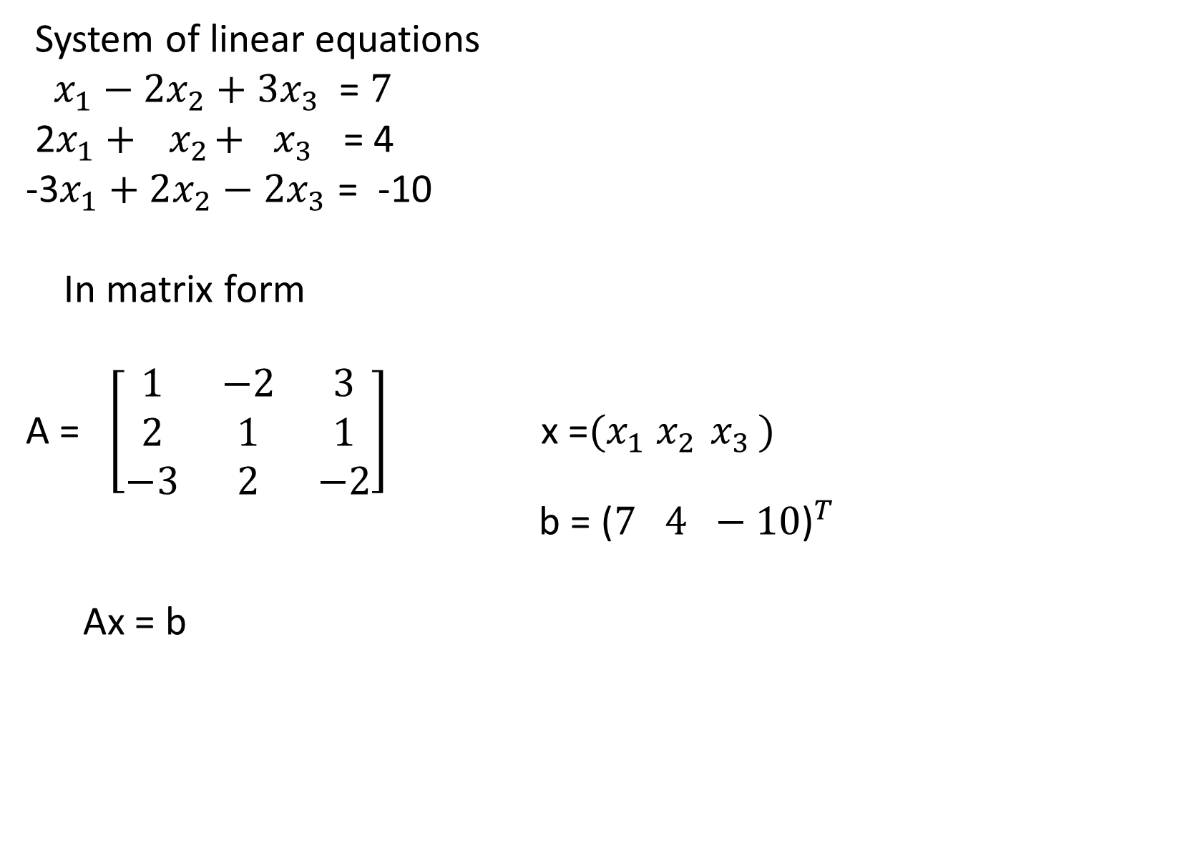
Mathematics of ML: system of linear equations
System of linear equations
${ x}_{1} − 2x_{2}+3x_{3}$ = $7$
2$x_{1}+{ x}_{2}+ x_{3}$ = 4
-3$x_{1}+2x_{2}−2x_{3}$ = -10
In matrix form
A = $\left[\begin{matrix}1 & −2 & 3 \\ 2 & 1 & 1 \\ −3 & 2 & −2\end{matrix}\right]$ x =${(x}_{1} x_{2 }x_{3 })$
b = ${\text{(}7 4 −10\text{)}}^{T}$
Ax = b

Slide 14
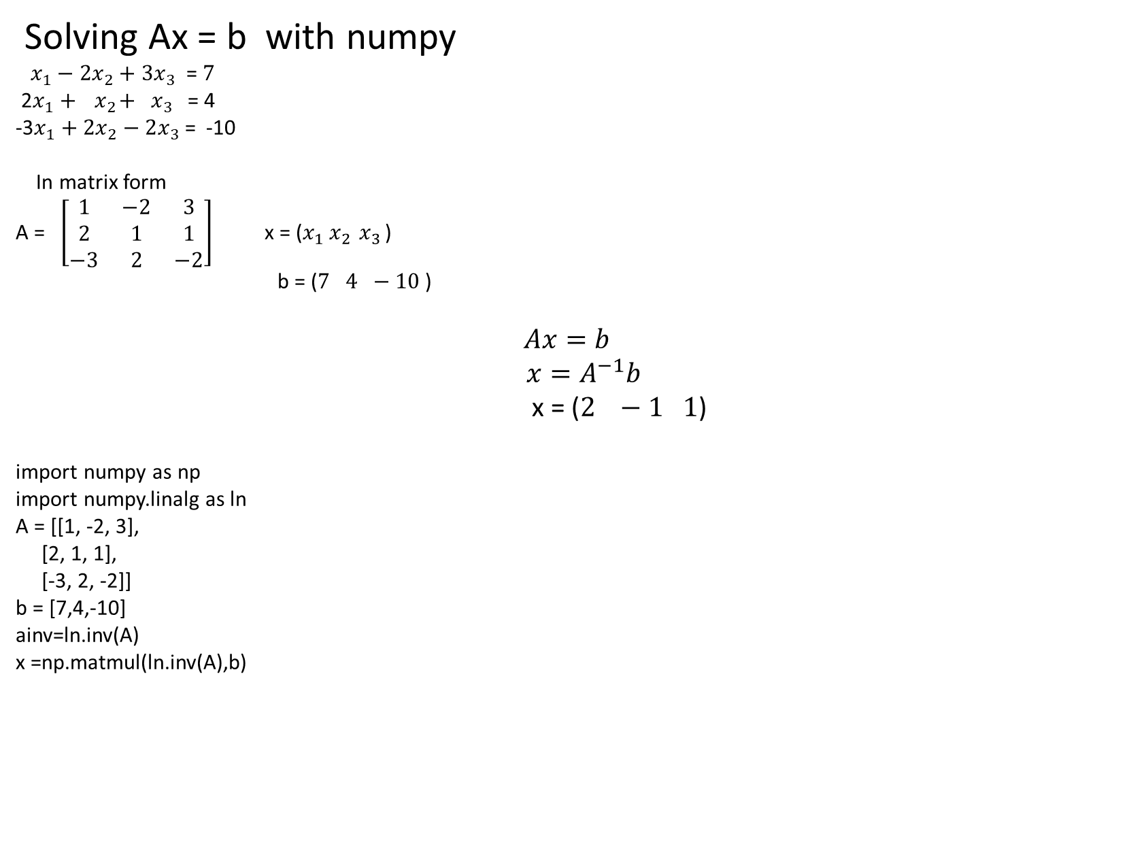
Mathematics of ML: system of linear equations
Solving Ax = b with numpy
${ x}_{1} − 2x_{2}+3x_{3}$ = $7$
2$x_{1}+{ x}_{2}+ x_{3}$ = 4
-3$x_{1}+2x_{2}−2x_{3}$ = -10
In matrix form
A = $\left[\begin{matrix}1 & −2 & 3 \\ 2 & 1 & 1 \\ −3 & 2 & −2\end{matrix}\right]$ x = ($x_{1}$ $x_{2 }x_{3 }$)
b = ($7$ $4 −10$)
$$Ax=b$$
$x=A^{−1}b$
x = ($2 −1 1$)
import numpy as np
import numpy.linalg as ln
A = [[1, -2, 3],
[2, 1, 1],
[-3, 2, -2]]
b = [7,4,-10]
ainv=ln.inv(A)
x =np.matmul(ln.inv(A),b)

Slide 15
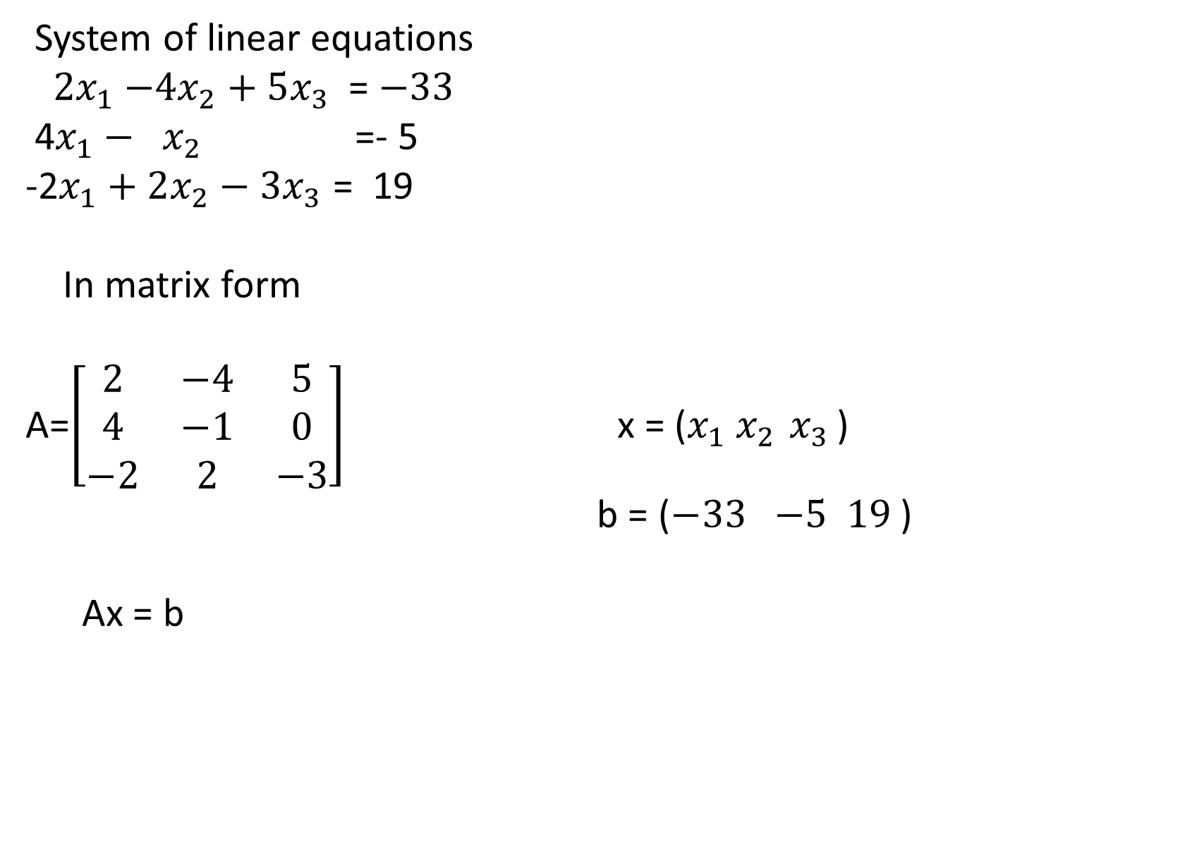
Mathematics of ML: system of linear equations
System of linear equations
${ 2x}_{1} −4x_{2}+5x_{3}$ = $−33$
4$x_{1}−{ x}_{2}$=- 5
-2$x_{1}+2x_{2}−3x_{3}$ = 19
In matrix form
A=$\left[\begin{matrix}2 & −4 & 5 \\ 4 & −1 & 0 \\ −2 & 2 & −3\end{matrix}\right]$ x = ($x_{1}$ $x_{2 }x_{3 }$)
b = ($−33$ $−5 19$)
Ax = b

Slide 16
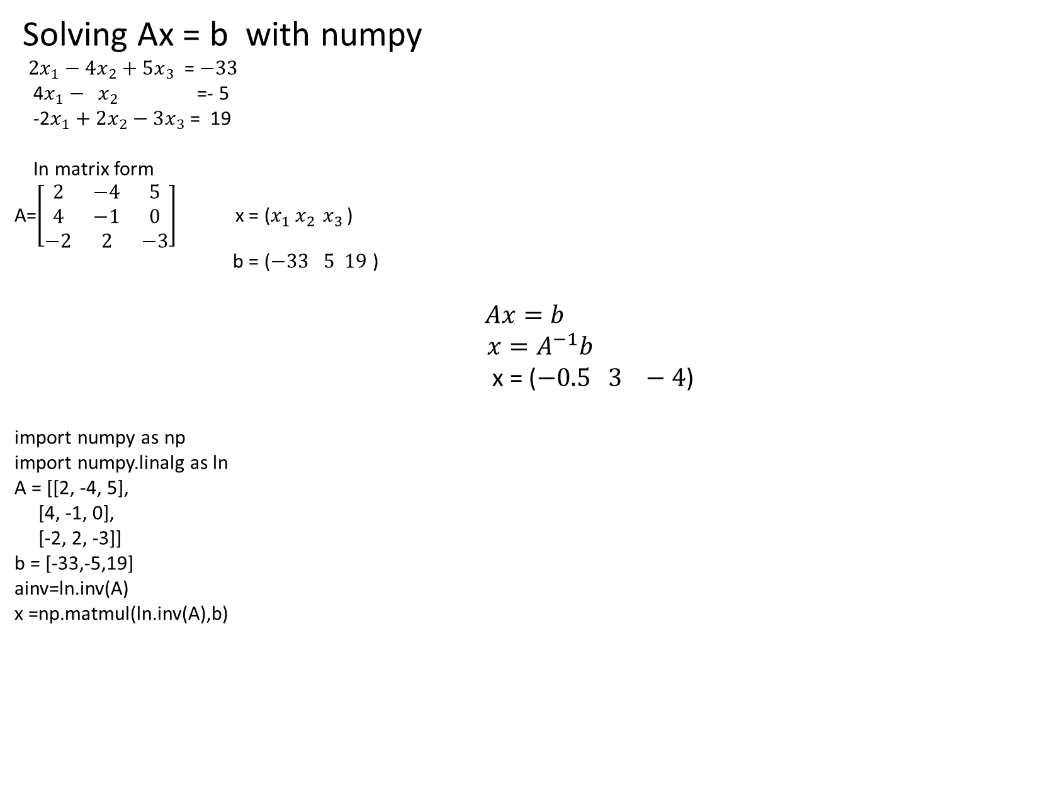
Mathematics of ML: system of linear equations
Solving Ax = b with numpy
${ 2x}_{1} − 4x_{2}+5x_{3}$ = $−33$
4$x_{1}−{ x}_{2}$=- 5
-2$x_{1}+2x_{2}−3x_{3}$ = 19
In matrix form
A=$\left[\begin{matrix}2 & −4 & 5 \\ 4 & −1 & 0 \\ −2 & 2 & −3\end{matrix}\right]$ x = ($x_{1}$ $x_{2 }x_{3 }$)
b = ($−33$ $5 19$)
$$Ax=b$$
$x=A^{−1}b$
x = ($−0.5 3 −4$)
import numpy as np
import numpy.linalg as ln
A = [[2, -4, 5],
[4, -1, 0],
[-2, 2, -3]]
b = [-33,-5,19]
ainv=ln.inv(A)
x =np.matmul(ln.inv(A),b)

Slide 17
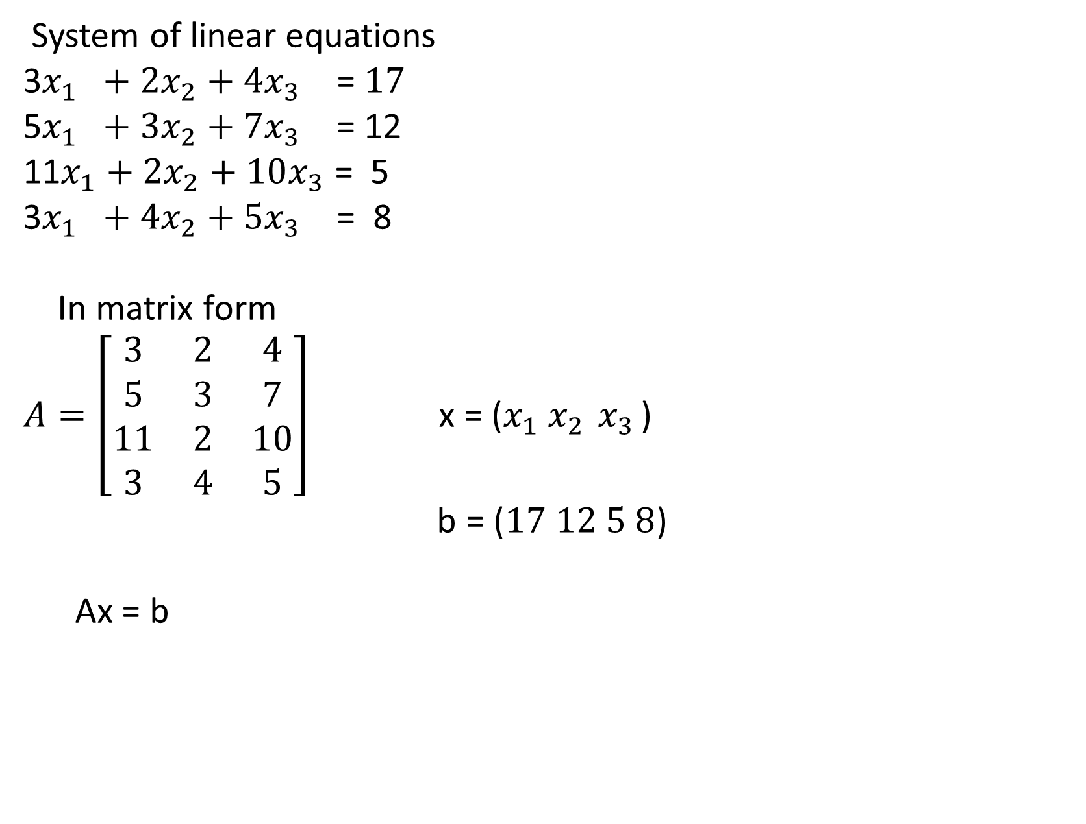
Mathematics of ML: system of linear equations
System of linear equations
3$x_{1} +2x_{2}+4x_{3}$ = $17$
5$x_{1} +3x_{2}+7x_{3}$ = 12
11$x_{1}+2x_{2}+10x_{3}$ = 5
3$x_{1} +4x_{2}+5x_{3}$ = 8
In matrix form
$A=\left[\begin{matrix}3 & 2 & 4 \\ 5 & 3 & 7 \\ 11 & 2 & 10 \\ 3 & 4 & 5\end{matrix}\right]$ x = ($x_{1}$ $x_{2 }x_{3 }$)
b = ($17$ $12 5 8$)
Ax = b

Slide 18
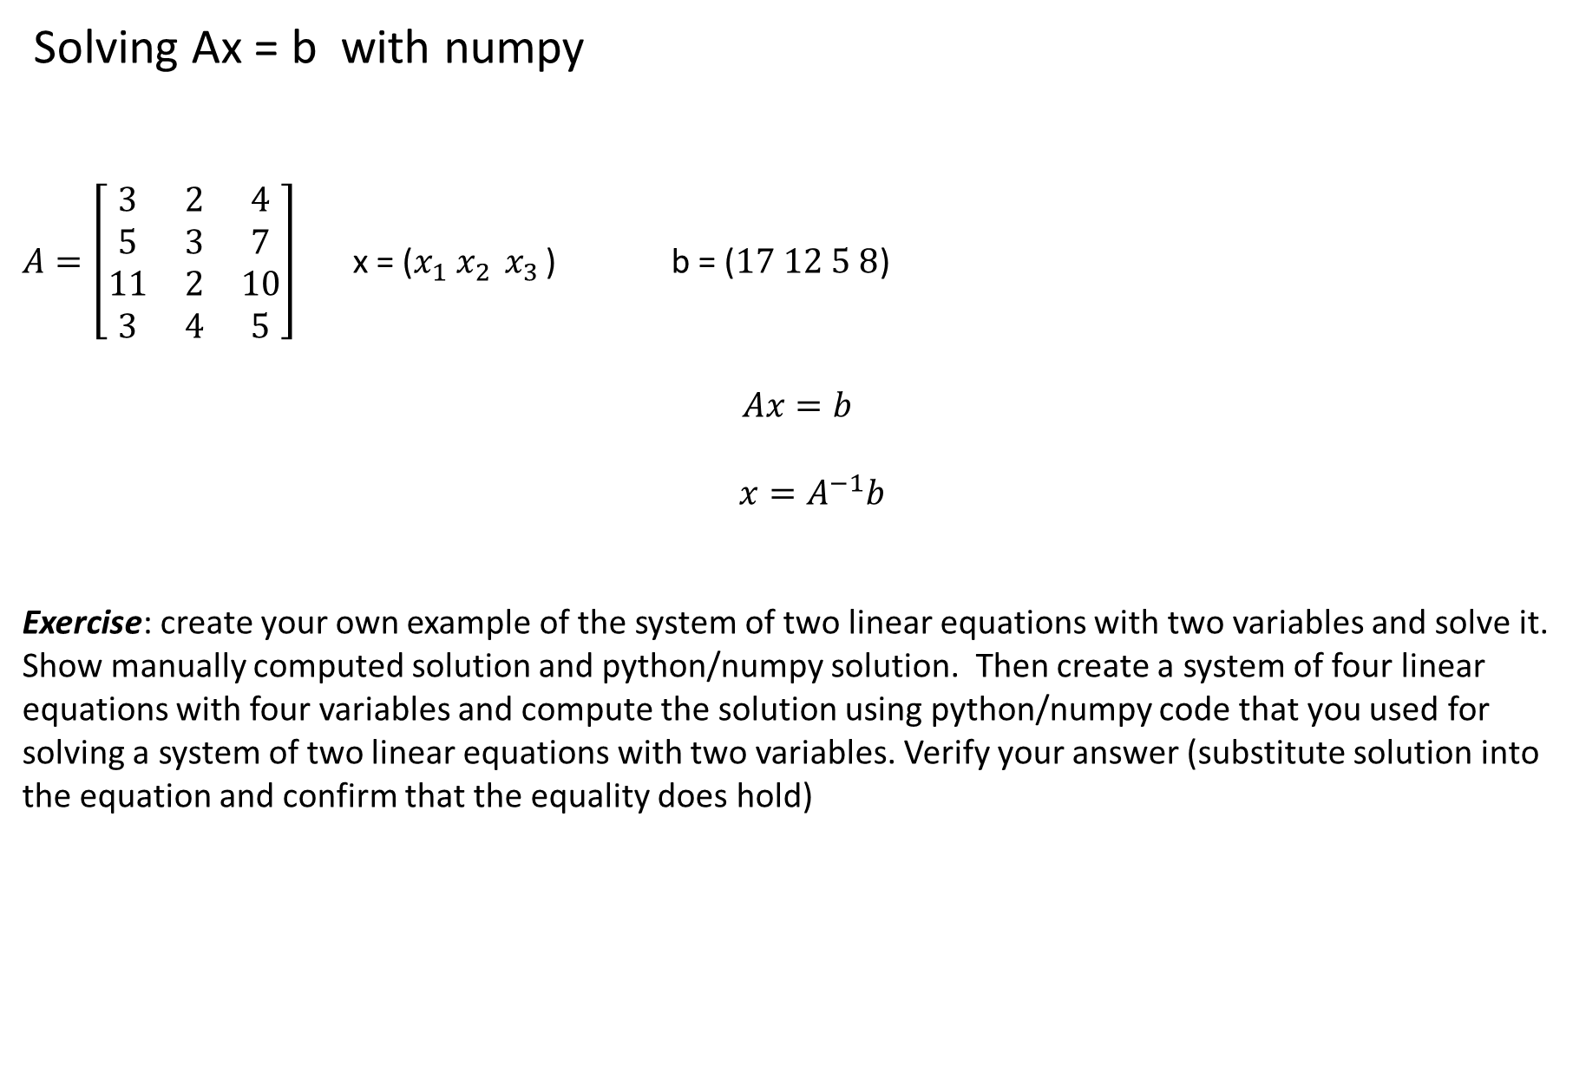
Mathematics of ML: system of linear equations
Solving Ax = b with numpy
$A=\left[\begin{matrix}3 & 2 & 4 \\ 5 & 3 & 7 \\ 11 & 2 & 10 \\ 3 & 4 & 5\end{matrix}\right]$ x = ($x_{1}$ $x_{2 }x_{3 }$) b = ($17$ $12 5 8$)
$$Ax=b$$
$x=A^{−1}b$
Exercise: create your own example of the system of two linear equations with two variables and solve it. Show manually computed solution and python/numpy solution. Then create a system of four linear equations with four variables and compute the solution using python/numpy code that you used for solving a system of two linear equations with two variables. Verify your answer (substitute solution into the equation and confirm that the equality does hold)

Slide 19
Example: Automatic airplanes classification
Speed (1Mach = 1225.04 km per hour)
Mass is in ton (1 ton=907.185 kg)

Slide 20
ML terminology
Automatic airplanes classification
Mass, Speed – features, (attributes, coordinates of a vector)
One row of data corresponds to one training example. It also corresponds to a vector or a point in the feature space.
Bomber, Fighter - class labels

Slide 21
Mathematics of ML: system of linear inequalities
Automatic Airplane classification
import matplotlib.pyplot as pl
X_bomber_mass = [1.0, 1.5, 2, 2.1,3.1]
X_bomber_speed = [ 1.1, 1.2, 1.3, 1.4, 1.5]
X_fighter_mass = [0.1,0.15, 0.2 , 0.5, 1.6 ]
X_fighter_speed = [0.3, 0.4, 0.5, 0.6, 0.7]
pl.figure()
pl.scatter(X_bomber_mass,X_bomber_speed)
pl.scatter(X_fighter_mass,X_fighter_speed)
pl.xlabel(‘mass’)
Pl.ylabel(‘speed’)
pl.show()
We look at three approaches to solve the problem:
Solve system of linear inequalities using mathematical software tools
Solve by perceptron learning algorithm
Solve using Support Vector Machines

Slide 22
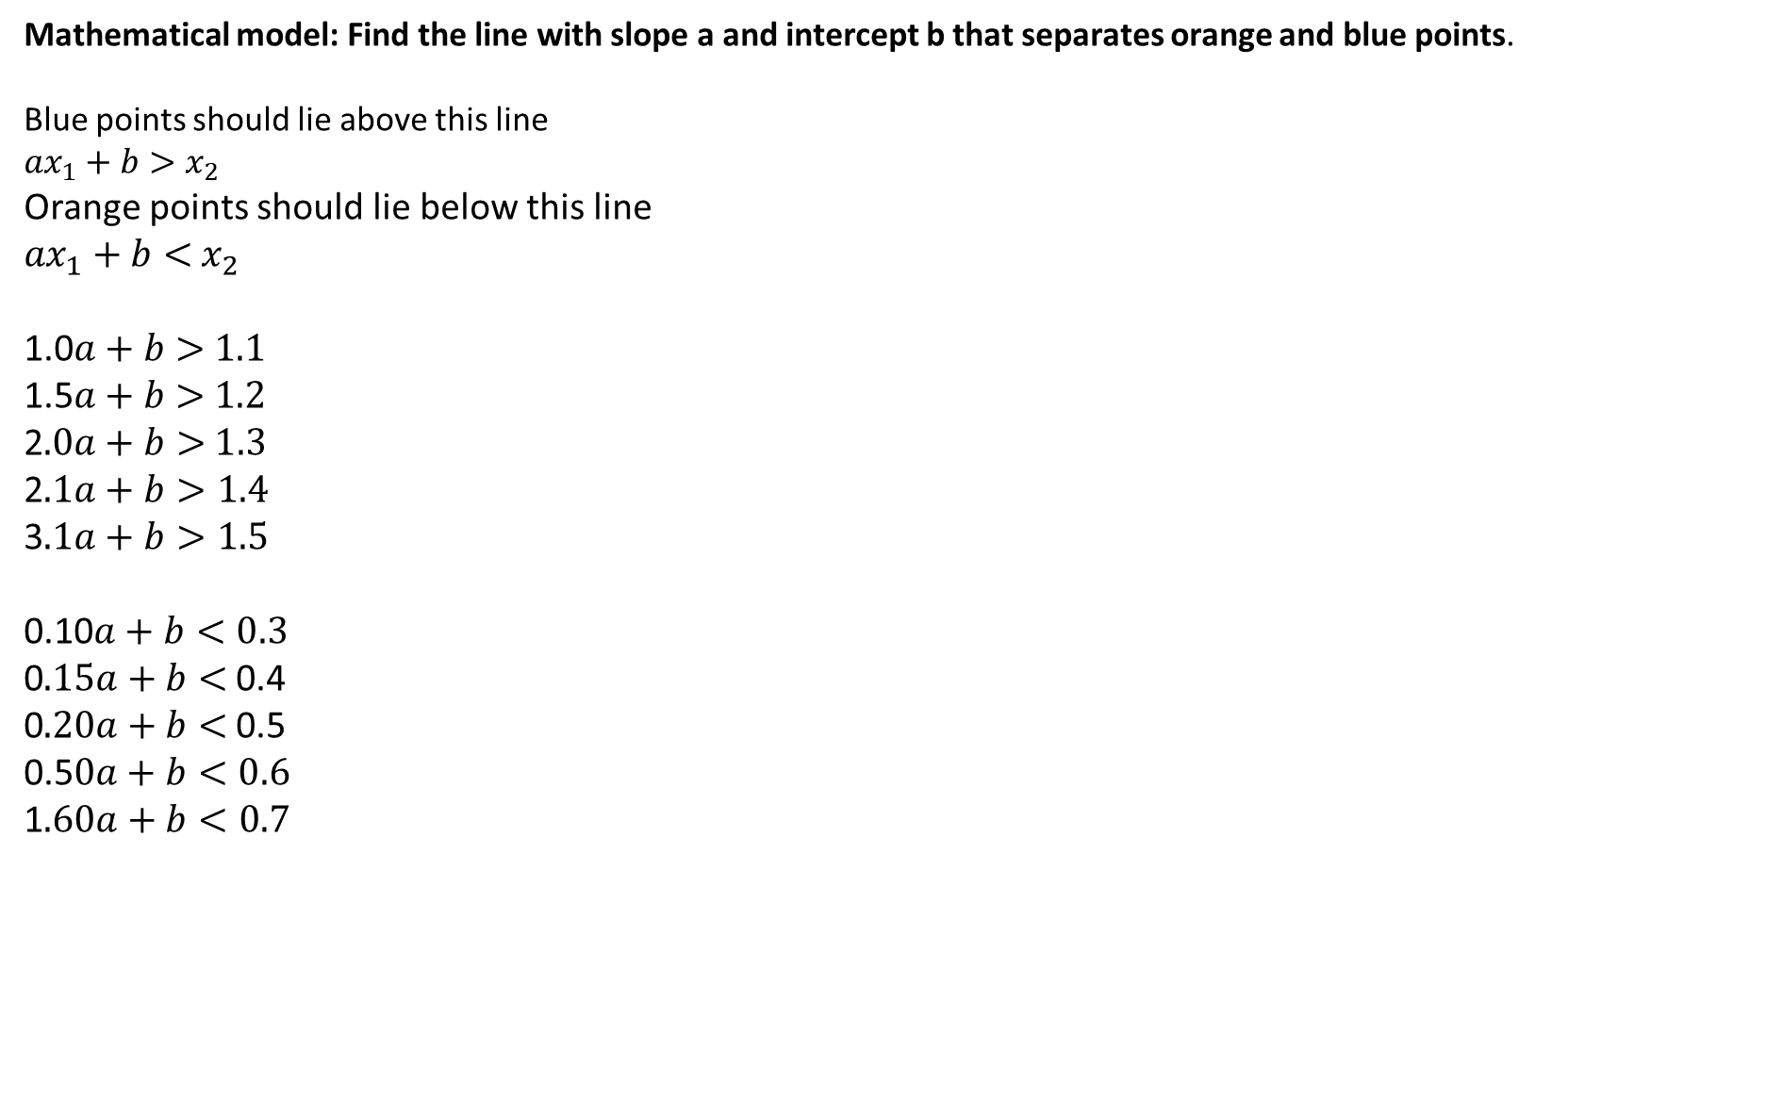
Mathematics of ML: system of linear inequalities
Mathematical model: Find the line with slope a and intercept b that separates orange and blue points.
Blue points should lie above this line
${ax}_{1}+b>$ $x_{2}$
Orange points should lie below this line
${ax}_{1}+b<$ $x_{2}$
1.0$a+b>$ $1.1$
1.5$a+b>$ $1.2$
2$.0a+b>$ $1.3$
2$.1a+b>1.4$
3$.1a+b>1.5$
0.10$a+b<0.3$
0$.15a+b<$ 0.4
0$.20a+b<$ 0.5
0.5$0a+b<0.6$
1$.60a+b<0.7$

Slide 23
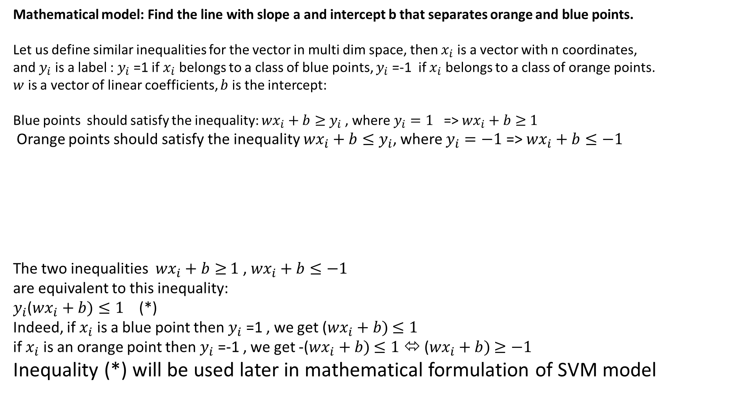
Mathematics of ML: system of linear inequalities
Mathematical model: Find the line with slope a and intercept b that separates orange and blue points.
Let us define similar inequalities for the vector in multi dim space, then $x_{i}$ is a vector with n coordinates,
and $y_{i}$ is a label : $y_{i}$ =1 if $x_{i}$ belongs to a class of blue points, $y_{i}$ =-1 if $x_{i}$ belongs to a class of orange points.
$w$ is a vector of linear coefficients, $b$ is the intercept:
Blue points should satisfy the inequality: ${wx}_{i}+b≥$ $y_{i}$ , where $y_{i}=1$ => ${wx}_{i}+b≥$ $1$
Orange points should satisfy the inequality ${wx}_{i}+b≤$ $y_{i}$, where $y_{i}=−1$ => ${wx}_{i}+b≤−1$
The two inequalities ${wx}_{i}+b≥$ $1$ , ${wx}_{i}+b≤−1$
are equivalent to this inequality:
$y_{i}$(${wx}_{i}+b)≤1$ (*)
Indeed, if $x_{i}$ is a blue point then $y_{i}$ =1 , we get (${wx}_{i}+b)$ $≤1$
if $x_{i}$ is an orange point then $y_{i}$ =-1 , we get -(${wx}_{i}+b)$ $≤1$ ⬄ (${wx}_{i}+b)$ $≥−1$
Inequality (*) will be used later in mathematical formulation of SVM model

Slide 24
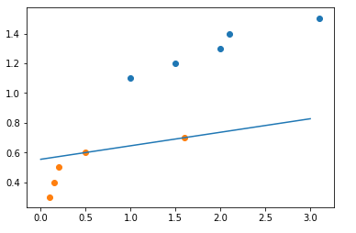
Mathematics of ML: system of linear inequalities
Solving system of linear inequalities using scipy
import matplotlib.pyplot as pl
import scipy.optimize as spo
import numpy as np
def line_f(a,b,x):
return a*x+b
X_bomber_mass = [1.0, 1.5, 2, 2.1,3.1]
X_bomber_speed = [ 1.1, 1.2, 1.3, 1.4, 1.5]
X_fighter_mass = [0.1,0.15, 0.2 , 0.5, 1.6 ]
X_fighter_speed = [0.3, 0.4, 0.5, 0.6, 0.7]
c = np.zeros(2)
bounds = [(-10,10),(-10,10)]
b_ub = -np.array([-1.1,-1.2,-1.2,-1.4,-1.5,0.3,0.4,0.5,0.6,0.7])
A_ub = -np.array([[-1,-1],[-1.5,-1],[-2,-1],[-2.1,-1],[-3.1,-1],[0.1,1],[0.15,1],[0.2,1],[0.5,1],[1.6,1]])
res=spo.linprog(c,A_ub,b_ub,bounds=bounds)
pl.figure()
pl.scatter(X_bomber_mass,X_bomber_speed)
pl.scatter(X_fighter_mass,X_fighter_speed)
x_line = np.array([0,3])
y_line = line_f(res.x[0],res.x[1],x_line)
pl.plot(x_line,y_line)
pl.show()

Slide 25
Mathematics of ML: system of linear inequalities
Other possible separators:
import matplotlib.pyplot as pl
import matplotlib.pyplot as pl
import scipy.optimize as spo
import numpy as np
def line_f(a,b,x):
return a*x+b
X_bomber_mass = [1.0, 1.5, 2, 2.1,3.1]
X_bomber_speed = [ 1.1, 1.2, 1.3, 1.4, 1.5]
X_fighter_mass = [0.1,0.15, 0.2 , 0.5, 1.6 ]
X_fighter_speed = [0.3, 0.4, 0.5, 0.6, 0.7]
c = np.zeros(2)
bounds = [(-10,10),(-10,10)]
b_ub = -np.array([-1.1,-1.2,-1.2,-1.4,-1.5,0.3,0.4,0.5,0.6,0.7])
A_ub = -np.array([[-1,-1],[-1.5,-1],[-2,-1],[-2.1,-1],[-3.1,-1],[0.1,1],[0.15,1],[0.2,1],[0.5,1],[1.6,1]])
res=spo.linprog(c,A_ub,b_ub,bounds=bounds)
pl.figure()
pl.scatter(X_bomber_mass,X_bomber_speed)
pl.scatter(X_fighter_mass,X_fighter_speed)
x_line = np.array([0,3])
y_line = line_f(res.x[0]+0.1,res.x[1],x_line)
pl.plot(x_line,y_line)
pl.show()
Problem: the separator line is not unique. This will be addressed in Linear Support Vector Machine classification method

Slide 26
Mathematics of ML: system of linear inequalities
What if we do not have mathematical software to solve systems of linear inequalities?
Consider sequential learning approach:
Assumption: observations are available one at a time.
Example: real time data such as stock price quotes.
The classification line is adjusted sequentially. As soon as new observation is available, the separation line is adjusted so that all observations known so far are classified correctly.
Such algorithms of sequential earning are called online learning algorithms.
Perceptron algorithm (Aiserman, Braverman, Rosonoer, 1964) :
The name of the algorithm comes from the connection with artificial neural networks (ANN). It ill be discussed later when we talk about ANN.
The simplest version of the algorithm finds the separation line between two classes of data. Kernel (nonlinear) version of the algorithm is discussed later.
The algorithm works for multi –dimensional datasets.
Here the algorithm is demonstrated on the airplane dataset. This dataset is a binary dataset ( two classes of data).

Slide 27
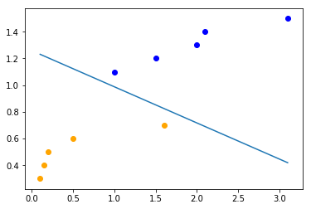
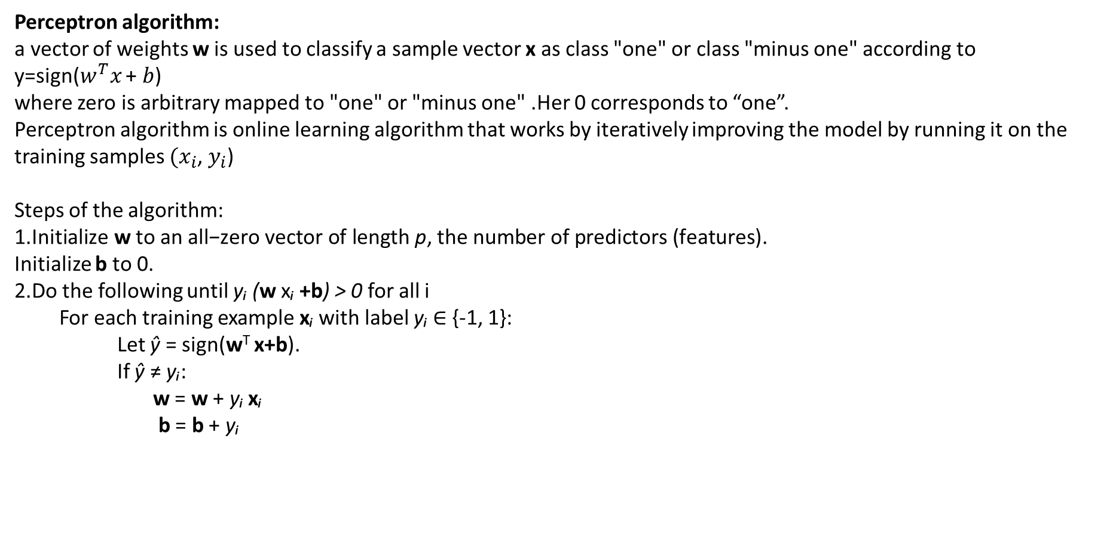
Mathematics of ML: system of linear inequalities
Perceptron algorithm:
a vector of weights w is used to classify a sample vector x as class "one" or class "minus one" according to
y=sign($w^{T}x$ + $b$)
where zero is arbitrary mapped to "one" or "minus one" .Her 0 corresponds to “one”.
Perceptron algorithm is online learning algorithm that works by iteratively improving the model by running it on the training samples ${(x}_{i}$, $y_{i}$)
Steps of the algorithm:
1.$\text{Initialize} \text{w} \text{to} \text{an} \text{all}\text{−}\text{zero} \text{vector} \text{of} \text{length} \text{p}\text{,} \text{the} \text{number} \text{of} \text{predictors} \text{(}\text{features}\text{).}$
Initialize b to 0.
2.Do the following until yᵢ (w xᵢ +b) > 0 for all i
For each training example xᵢ with label yᵢ ∈ {-1, 1}:
Let ŷ = sign(w^{T} x+b).
If ŷ ≠ yᵢ:
w = w + yᵢ xᵢ
b = b + yᵢ

Slide 28
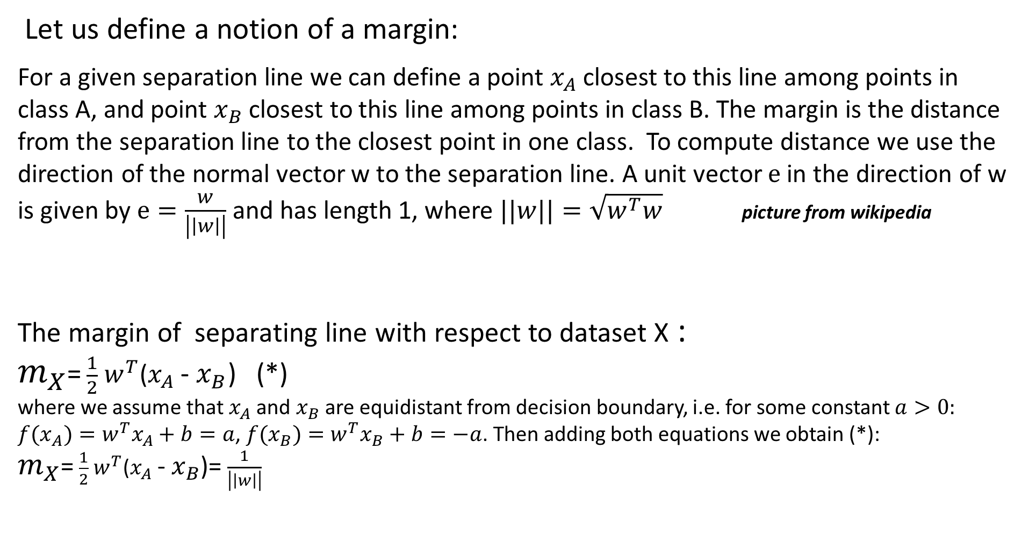
Mathematics of ML: linear support vector machine
Let us define a notion of a margin:
For a given separation line we can define a point $x_{A}$closest to this line among points in class A, and point $x_{B}$ closest to this line among points in class B. The margin is the distance from the separation line to the closest point in one class. To compute distance we use the direction of the normal vector w to the separation line. A unit vector $e$ in the direction of w is given by $e=\frac{w}{\left|\left|w\right|\right|}$ and has length 1, where $||w||=\sqrt{w^{T}w}$ picture from wikipedia
The margin of separating line with respect to dataset X :
$m_{X}$= $\frac{1}{2}$ $w^{T}$($x_{A}$- $x_{B}$) (*)
where we assume that $x_{A}$and $x_{B}$are equidistant from decision boundary, i.e. for some constant $a>0:$ ${f{(x}_{A})=w}^{T}x_{A}+b=a$, ${f{(x}_{B})=w}^{T}x_{B}+b=−a$. Then adding both equations we obtain (*):
$m_{X}$= $\frac{1}{2}$ $w^{T}$($x_{A}$- $x_{B}$)= $\frac{1}{\left|\left|w\right|\right|}$

Slide 29
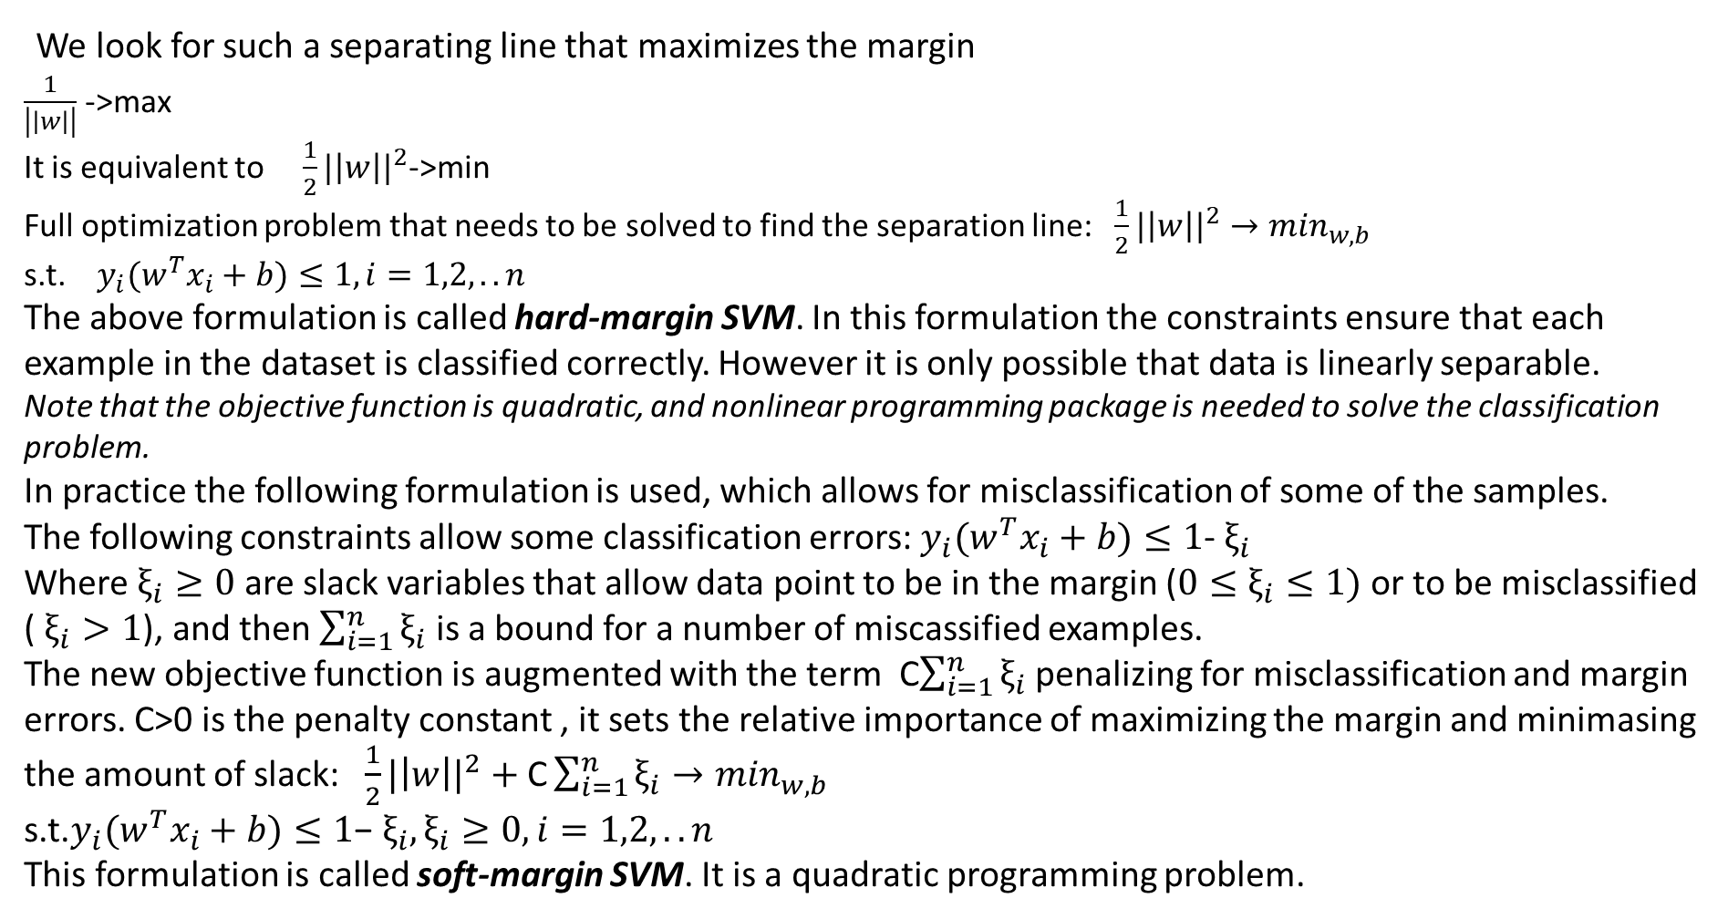
Mathematics of ML: linear support vector machine
We look for such a separating line that maximizes the margin
$\frac{1}{\left|\left|w\right|\right|}$ ->max
It is equivalent to ${\frac{1}{2}|\left|w\right||}^{2}$->min
Full optimization problem that needs to be solved to find the separation line: ${\frac{1}{2}|\left|w\right||}^{2}→\min_{w,b}$
s.t.${y_{i}(w}^{T}x_{i}+b)≤1, i=1,2,..n$
The above formulation is called hard-margin SVM. In this formulation the constraints ensure that each example in the dataset is classified correctly. However it is only possible that data is linearly separable.
Note that the objective function is quadratic, and nonlinear programming package is needed to solve the classification problem.
In practice the following formulation is used, which allows for misclassification of some of the samples.
The following constraints allow some classification errors: ${y_{i}(w}^{T}x_{i}+b)≤1$- $ξ_{i}$
Where $ξ_{i}≥0$ are slack variables that allow data point to be in the margin (${0≤ξ}_{i}≤1)$ or to be misclassified ( $ξ_{i}>1$), and then $\sum_{i=1}^{n}{ξ_{i}}$ is a bound for a number of miscassified examples.
The new objective function is augmented with the term C$\sum_{i=1}^{n}{ξ_{i}}$ penalizing for misclassification and margin errors. C>0 is the penalty constant , it sets the relative importance of maximizing the margin and minimasing the amount of slack: ${\frac{1}{2}|\left|w\right||}^{2} \text{+ }\text{C}\sum_{i=1}^{n}{ξ_{i}}→\min_{w,b}$
s.t.${y_{i}(w}^{T}x_{i}+b)≤1\text{−} ξ_{i},ξ_{i}≥0, i=1,2,..n$
This formulation is called soft-margin SVM. It is a quadratic programming problem.

Slide 30
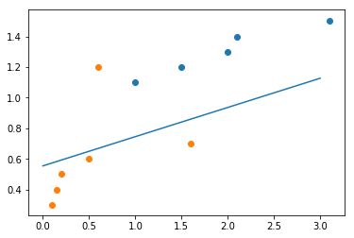
Mathematics of ML: linear support vector machine
The following class in scikit-learn implements Linear Support Vector Machine classifier:
Note
class sklearn.svm.LinearSVC(penalty='l2', loss='squared_hinge', dual=True, tol=0.0001, C=1.0, multi_class='ovr', fit_intercept=True, intercept_scaling=1, class_weight=None, verbose=0, random_state=None, max_iter=1000
The following code applies Linear Support Vector Classification to airplane data:
X_bomber_mass = [1.0, 1.5, 2, 2.1,3.1]
X_bomber_speed = [ 1.1, 1.2, 1.3, 1.4, 1.5]
X_fighter_mass = [0.1,0.15, 0.2 , 0.5, 1.6 ]
X_fighter_speed = [0.3, 0.4, 0.5, 0.6, 0.7]
x=list(zip(X_bomber_mass,X_bomber_speed))
x1=list(zip(X_fighter_mass,X_fighter_speed))
x.extend(x1)
y=[0,0,0,0,0,1,1,1,1,1]
svc=svm.LinearSVC()
svcfit=svc.fit(x,y)
svcfit.predict(x)
If default value for constant C is 1.0 .predict(x) does not classify all input data correctly. However if C is increased (penalty for misclassification is increased) all input data points are classified correctly.
Exercise: add one data point to the dataset so the data becomes linearly
non-separable and modify the above code so that this new datapoint
is misclassified but old points are classified correctly.
For example, add the points as in the picture

Slide 31
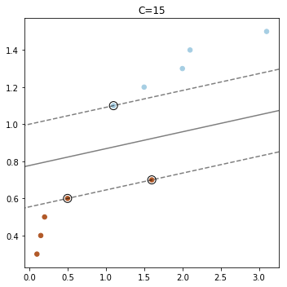
Mathematics of ML: linear support vector machine
Example: train Linear SVM with airplane data. plot support vectors
import numpy as np
import matplotlib.pyplot as plt
from sklearn.datasets import make_blobs
from sklearn.svm import LinearSVC
X_bomber_mass = [1.0, 1.5, 2, 2.1,3.1]
X_bomber_speed = [ 1.1, 1.2, 1.3, 1.4, 1.5]
X_fighter_mass = [0.1,0.15, 0.2 , 0.5, 1.6 ]
X_fighter_speed = [0.3, 0.4, 0.5, 0.6, 0.7]
X=list(zip(X_bomber_mass,X_bomber_speed))
x1=list(zip(X_fighter_mass,X_fighter_speed))
X.extend(x1)
X=np.array(X)
y=[0,0,0,0,0,1,1,1,1,1]
y=np.array(y)
plt.figure(figsize=(5, 5))
# "hinge" is the standard SVM loss
clf = LinearSVC(C=15, loss="hinge", random_state=42).fit(X, y)
# obtain the support vectors through the decision function
decision_function = clf.decision_function(X)
# we can also calculate the decision function manually
# decision_function = np.dot(X, clf.coef_[0]) + clf.intercept_[0]
support_vector_indices = np.where((2 * y - 1) * decision_function <= 1)[0]
support_vectors = X[support_vector_indices]
plt.scatter(X[:, 0], X[:, 1], c=y, s=30, cmap=plt.cm.Paired)
ax = plt.gca()
xlim = ax.get_xlim()
ylim = ax.get_ylim()
xx, yy = np.meshgrid(np.linspace(xlim[0], xlim[1], 50),
np.linspace(ylim[0], ylim[1], 50))
Z = clf.decision_function(np.c_[xx.ravel(), yy.ravel()])
Z = Z.reshape(xx.shape)
plt.contour(xx, yy, Z, colors='k', levels=[-1, 0, 1], alpha=0.5,
linestyles=['--', '-', '--'])
plt.scatter(support_vectors[:, 0], support_vectors[:, 1], s=100,
linewidth=1, facecolors='none', edgecolors='k')
plt.title("C=15")
plt.tight_layout()
plt.show()

Slide 32
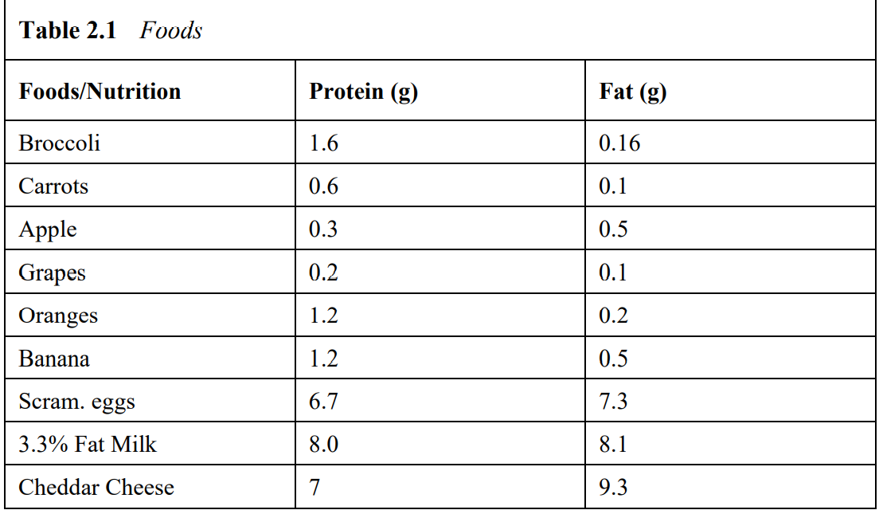
Example: identification of food groups

Slide 33
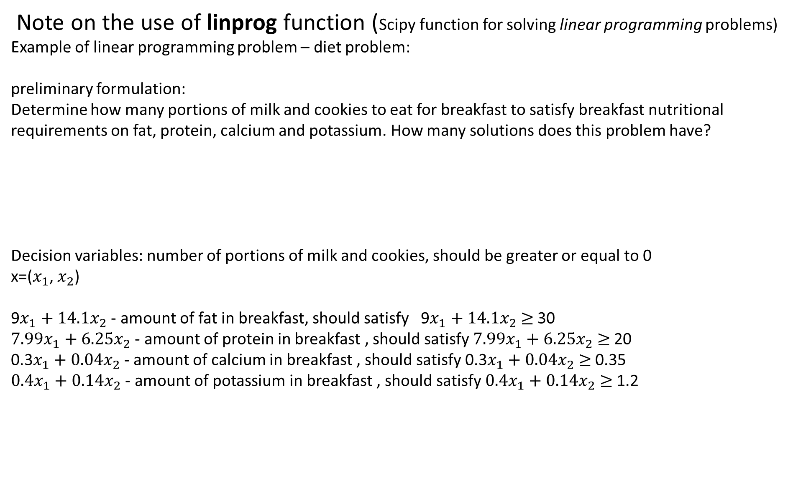
Mathematics of AI I: system of linear inequalities
Note on the use of linprog function (Scipy function for solving linear programming problems)
Example of linear programming problem – diet problem:
preliminary formulation:
Determine how many portions of milk and cookies to eat for breakfast to satisfy breakfast nutritional requirements on fat, protein, calcium and potassium. How many solutions does this problem have?
Decision variables: number of portions of milk and cookies, should be greater or equal to 0
x=($x_{1}$, $x_{2}$)
9$x_{1}+{14.1x}_{2}$ - amount of fat in breakfast, should satisfy 9$x_{1}+{14.1x}_{2}$ $≥$30
$7.99x_{1}+{6.25x}_{2}$ - amount of protein in breakfast , should satisfy $7.99x_{1}+{6.25x}_{2}$ $≥$20
0.3$x_{1}+{0.04x}_{2}$ - amount of calcium in breakfast , should satisfy 0.3$x_{1}+{0.04x}_{2}$ $≥$0.35
$0.4x_{1}+{0.14x}_{2}$ - amount of potassium in breakfast , should satisfy $0.4x_{1}+{0.14x}_{2}$ $≥$1.2
 | fat(g) | protein(g) | calcium(g) | potassium(g)
Milk (whole), 1cup | 9 | 7.99 | 0.3 | 0.4
Oatmeal cookie | 14.1 | 6.25 | 0.04 | 0.14
Nutritional requirements | 30 | 20 | 0.35 | 1.2

Slide 34
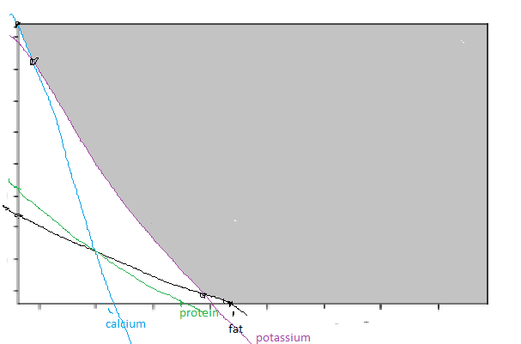
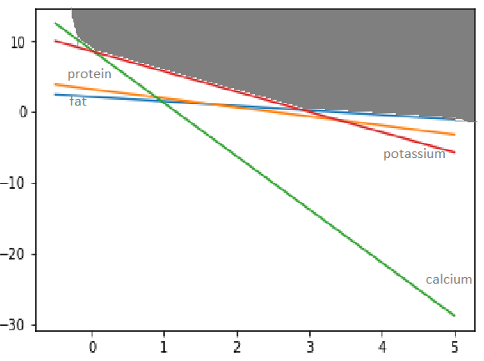
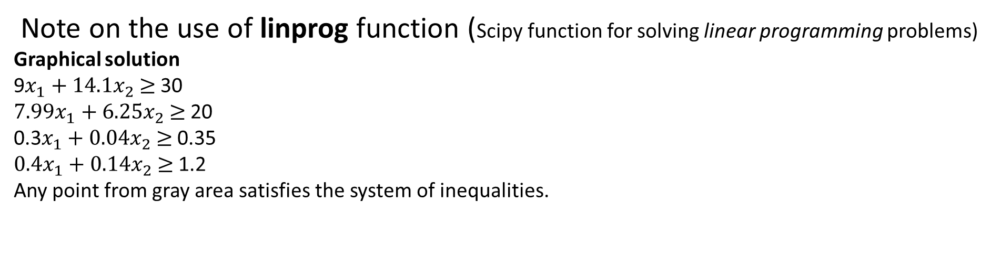
Mathematics of ML: system of linear inequalities
Note on the use of linprog function (Scipy function for solving linear programming problems)
Graphical solution
9$x_{1}+{14.1x}_{2}$ $≥$30
$7.99x_{1}+{6.25x}_{2}$ $≥$20
0.3$x_{1}+{0.04x}_{2}$ $≥$0.35
$0.4x_{1}+{0.14x}_{2}$ $≥$1.2
Any point from gray area satisfies the system of inequalities.
 | fat(g) | protein(g) | calcium(g) | potassium(g)
Milk (whole), 1cup | 9 | 7.99 | 0.3 | 0.4
Oatmeal cookie | 14.1 | 6.25 | 0.04 | 0.14
Nutritional requirements | 30 | 20 | 0.35 | 1.2
In linear programming (LP) terms: Gray area is the feasible region of the LP problem.

Slide 35
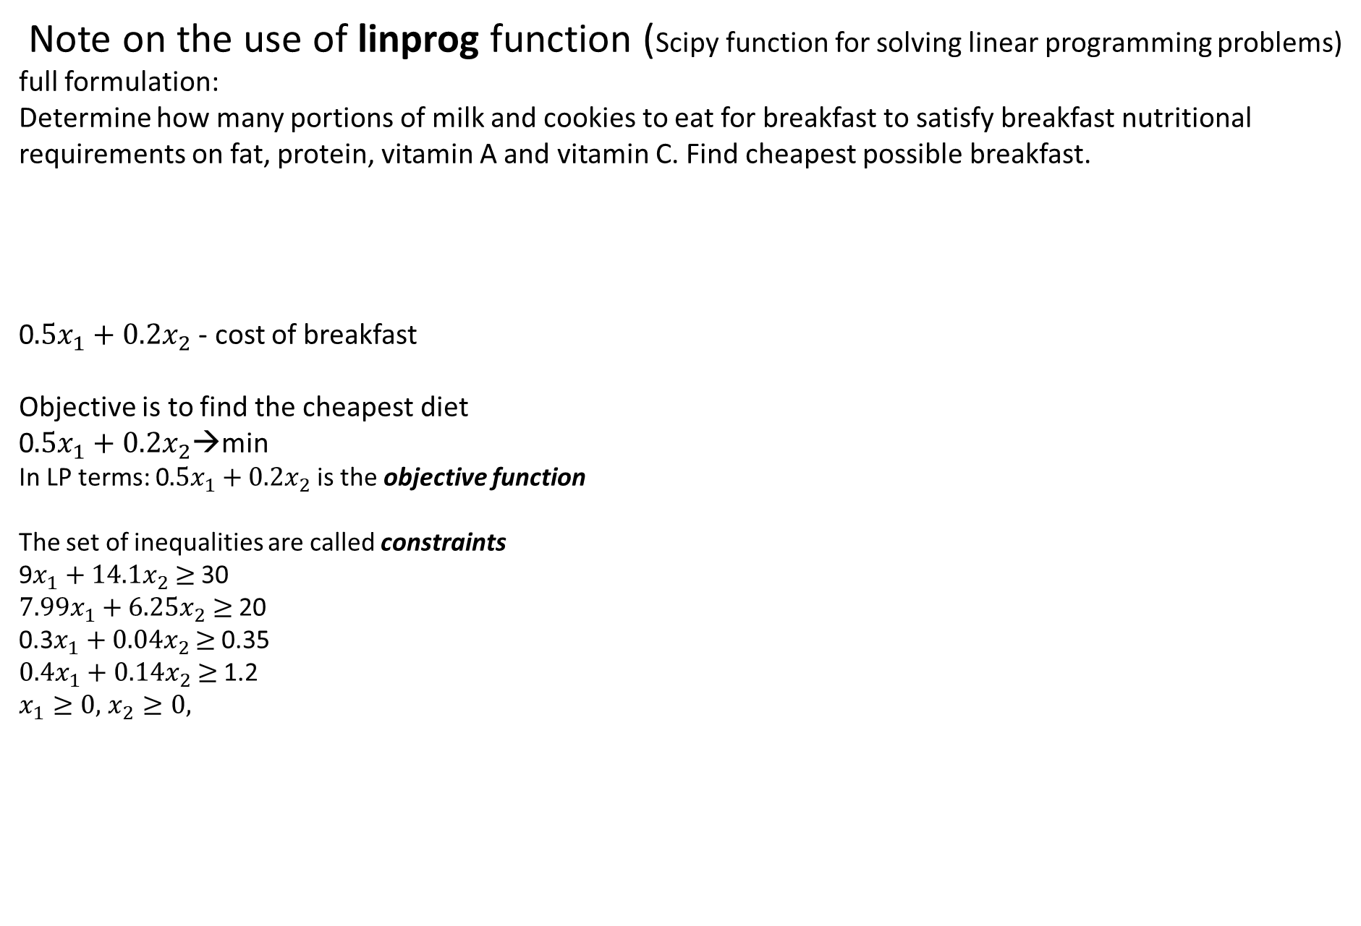
Mathematics of ML: system of linear inequalities
Note on the use of linprog function (Scipy function for solving linear programming problems)
full formulation:
Determine how many portions of milk and cookies to eat for breakfast to satisfy breakfast nutritional requirements on fat, protein, vitamin A and vitamin C. Find cheapest possible breakfast.
0$.5x_{1}+{0.2x}_{2}$ - cost of breakfast
Objective is to find the cheapest diet
0$.5x_{1}+{0.2x}_{2}$→min
In LP terms: 0$.5x_{1}+{0.2x}_{2}$ is the objective function
The set of inequalities are called constraints
9$x_{1}+{14.1x}_{2}$ $≥$30
$7.99x_{1}+{6.25x}_{2}$ $≥$20
0.3$x_{1}+{0.04x}_{2}$ $≥$0.35
$0.4x_{1}+{0.14x}_{2}$ $≥$1.2
$x_{1}≥0,$ $x_{2}≥0,$
 | fat(g) | protein(g) | calcium(g) | potassium(g) | cost($)
Milk (whole), 1cup | 9 | 7.99 | 0.3 | 0.4 | 0.5
Oatmeal cookie | 14.1 | 6.25 | 0.04 | 0.14 | 0.2

Slide 36
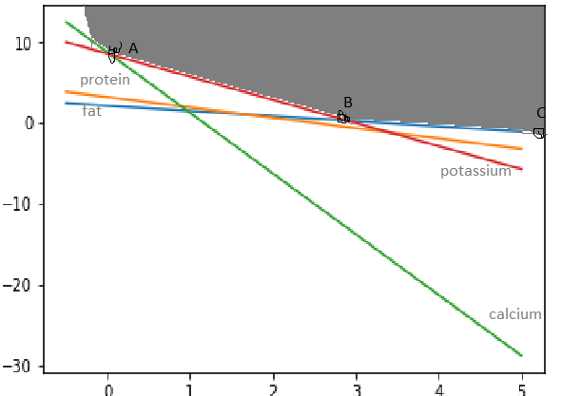
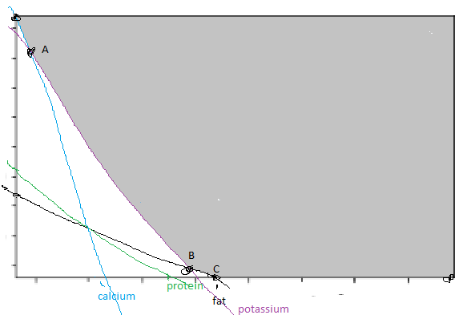
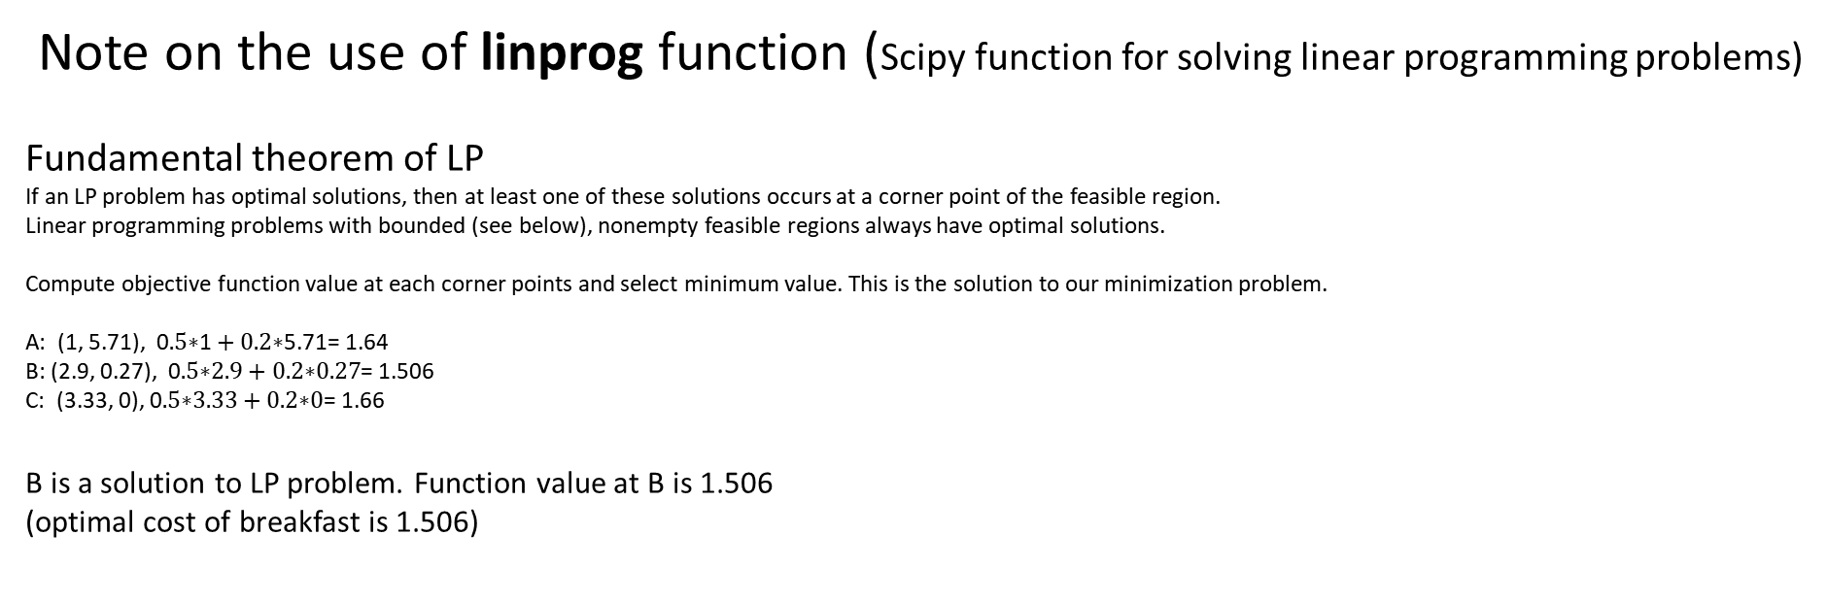
Mathematics of ML: system of linear inequalities
Note on the use of linprog function (Scipy function for solving linear programming problems)
Fundamental theorem of LP
If an LP problem has optimal solutions, then at least one of these solutions occurs at a corner point of the feasible region.
Linear programming problems with bounded (see below), nonempty feasible regions always have optimal solutions.
Compute objective function value at each corner points and select minimum value. This is the solution to our minimization problem.
A: (1, 5.71), 0$.5\text{∗}\text{1}+\text{0.2∗}\text{5.71}$= 1.64
B: (2.9, 0.27), 0$.5\text{∗}\text{2.9}+\text{0.2∗}\text{0.2}\text{7}$= 1.506
C: (3.33, 0), 0$.5\text{∗}\text{3.33}+\text{0.2∗}\text{0}$= 1.66
B is a solution to LP problem. Function value at B is 1.506
(optimal cost of breakfast is 1.506)

Slide 37
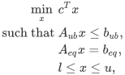
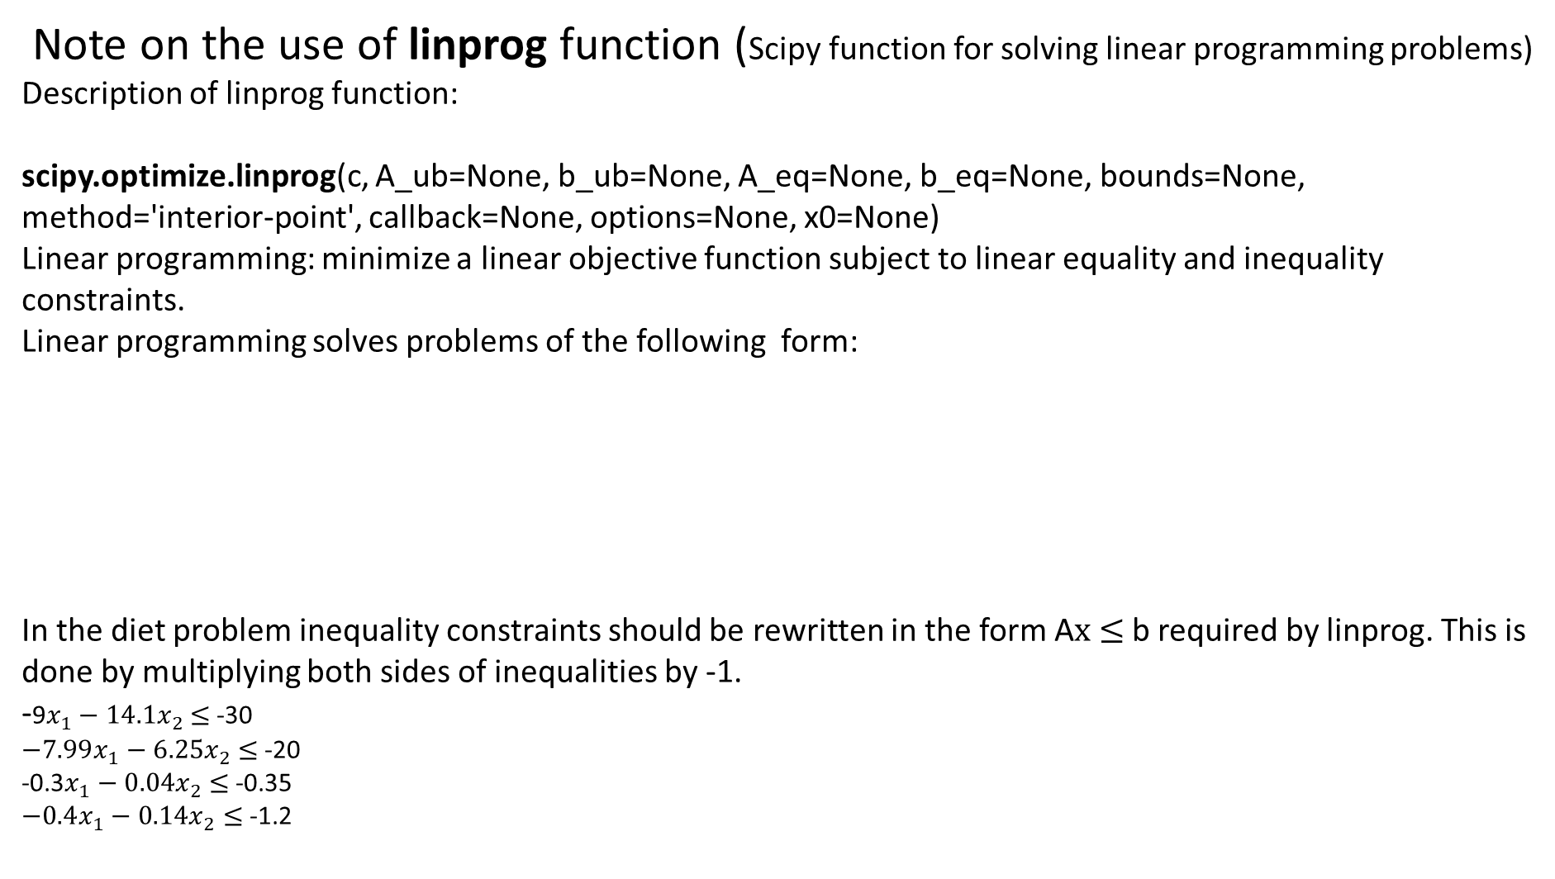
Mathematics of ML: system of linear inequalities
Note on the use of linprog function (Scipy function for solving linear programming problems)
Description of linprog function:
scipy.optimize.linprog(c, A_ub=None, b_ub=None, A_eq=None, b_eq=None, bounds=None, method='interior-point', callback=None, options=None, x0=None)
Linear programming: minimize a linear objective function subject to linear equality and inequality constraints.
Linear programming solves problems of the following form:
In the diet problem inequality constraints should be rewritten in the form A$x$ $≤$b required by linprog. This is done by multiplying both sides of inequalities by -1.
-9$x_{1}−{14.1x}_{2}$ $≤$-30
$−7.99x_{1}−{6.25x}_{2}$ $≤$-20
-0.3$x_{1}−{0.04x}_{2}$ $≤$-0.35
$−0.4x_{1}−{0.14x}_{2}$ $≤$-1.2

Slide 38
Mathematics of ML: system of linear inequalities
Note on the use of linprog function (Scipy function for solving linear programming problems)
This is Python code for solving diet problem
import scipy.optimize as spo
import numpy as np
c = np.array([0.5,0.2])
bounds = [(0,10),(0,30)]
b_ub = -np.array([30,20,0.35,1.2])
A_ub = -np.array([[9,14.1],[7.99,6.25],[0.3,0.04],[0.4,0.14]])
res=spo.linprog(c,A_ub,b_ub,bounds=bounds)
Solution is to drink 2.90410959 cups of milk and eat 0.2739726 portion of cookies.
The cost of breakfast s 1.506849315068493
If milk intake is restricted to 2 cups: bounds = [(0,2),(0,30)]
Then solution is to drink 2 cups of milk and eat 2.85714286 cookies. The cost of breakfast is 1.571428

Slide 39
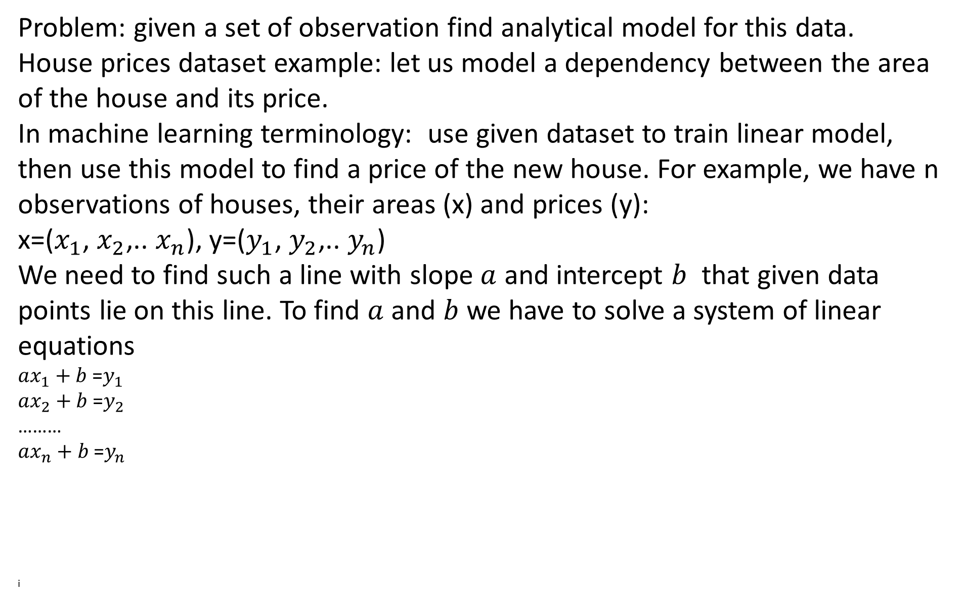
Mathematics of ML: system of linear equations
Problem: given a set of observation find analytical model for this data.
House prices dataset example: let us model a dependency between the area of the house and its price.
In machine learning terminology: use given dataset to train linear model, then use this model to find a price of the new house. For example, we have n observations of houses, their areas (x) and prices (y):
x=($x_{1}$, $x_{2}$,.. $x_{n}$), y=($y_{1}$, $y_{2}$,.. $y_{n}$)
We need to find such a line with slope $a$ and intercept $b$ that given data points lie on this line. To find $a$ and $b$we have to solve a system of linear equations
$ax_{1}+b$=$y_{1}$
$ax_{2}+b$=$y_{2}$
………
$ax_{n}+b$=$y_{n}$
i

Slide 40
Mathematics of ML: system of linear equations
Solve this system of equations using Python linear algebra module
import matplotlib.pyplot as pl
import numpy as np
X = [1000.0, 1300, 1400, 1700,2500]
Y = [ 2000, 2100, 2500, 2600, 4000]
pl.figure()
pl.scatter(X,Y)
pl.show()
i

Slide 41
Mathematics of ML: system of linear equations
Solve this system using Python linear algebra module
import matplotlib.pyplot as pl
import numpy as np
X = [1000.0, 1300, 1400, 1700,2500]
Y = [ 2000, 2100, 2500, 2600, 4000]
pl.figure()
pl.scatter(X,Y)
pl.show()
i

Slide 42
Mathematics of ML: system of linear equtions
Solve this system using Scipy optimization library
import matplotlib.pyplot as pl
import numpy as np
import scipy.optimize as so
def func_line(x, a, b):
return a * x + b
X =np.array( [1000.0, 1300, 1400, 1700,2500])
Y =np.array( [ 2000, 2100, 2500, 2600, 4000])
pl.figure()
pl.scatter(X,Y)
popt, pcov = so.curve_fit(func_line,X, Y)
yExp = func_line(X,popt[0], popt[1])
pl.plot(X,yExp, label = 'fitted line')
pl.show()
i

Slide 43
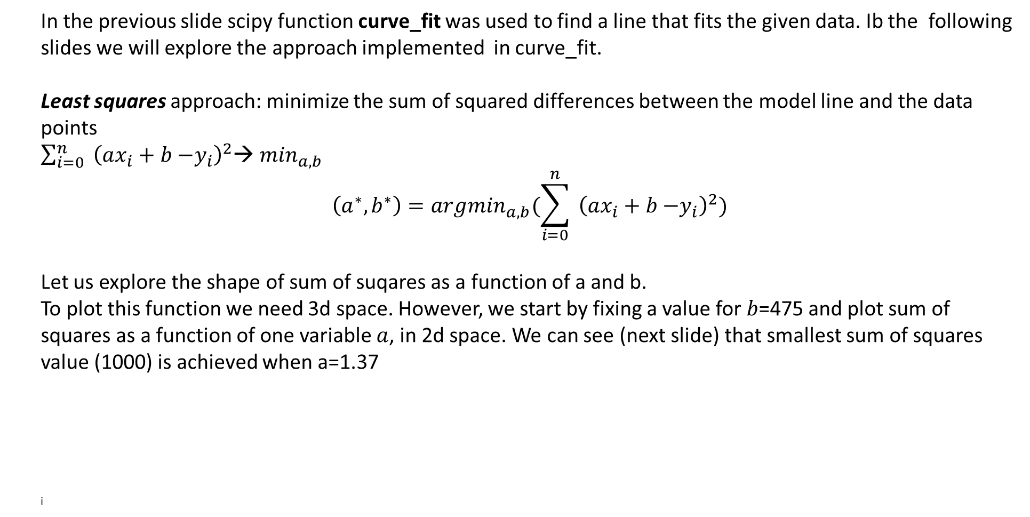
Mathematics of ML: least squares
In the previous slide scipy function curve_fit was used to find a line that fits the given data. Ib the following slides we will explore the approach implemented in curve_fit.
Least squares approach: minimize the sum of squared differences between the model line and the data points
$\sum_{i=0}^{n}{ {\left(ax_{i}+b \text{−}y_{i}\right)}^{2}}$→ $\min_{a,b}$
$$\left(a^{∗},b^{∗}\right)={argmin}_{a,b}(\sum_{i=0}^{n}{ {\left(ax_{i}+b \text{−}y_{i}\right)}^{2})}$$
Let us explore the shape of sum of suqares as a function of a and b.
To plot this function we need 3d space. However, we start by fixing a value for $b$=475 and plot sum of squares as a function of one variable $a$, in 2d space. We can see (next slide) that smallest sum of squares value (1000) is achieved when a=1.37
i

Slide 44
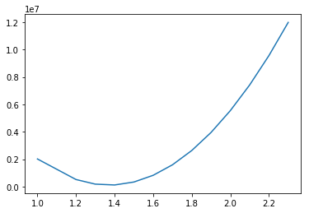
Mathematics of ML: least squares
import matplotlib.pyplot as pl
import numpy as np
X =np.array( [1000.0, 1300, 1400, 1700,2500])
Y =np.array( [ 2000, 2100, 2500, 2600, 4000])
def sum_sq(a,b):
s = np.zeros(len(a))
for i in range(len(a)):
s[i]=sum((a[i]*X+b-Y)*(a[i]*X+b-Y))
return s
pl.figure()
a = np.array([1,1.2,1.3,1.4,1.5,1.6,1.7,1.8,1.9,2.0,2.1,2.2,2.3])
b=0.1
Y_sum_sq = sum_sq(a,b)
pl.plot(a,Y_sum_sq, label = 'fitted line')
pl.show()
i

Slide 45
Mathematics of ML: least squares
import matplotlib.pyplot as pl
import numpy as np
X =np.array( [1000.0, 1300, 1400, 1700,2500])
Y =np.array( [ 2000, 2100, 2500, 2600, 4000])
def sum_sq(a,b):
s = np.zeros(len(a))
for i in range(len(a)):
s[i]=sum((a[i]*X+b-Y)*(a[i]*X+b-Y))
return s
pl.figure()
a = np.array([1,1.2,1.3,1.4,1.5,1.6,1.7,1.8,1.9,2.0,2.1,2.2,2.3])
b=0.1
Y_sum_sq = sum_sq(a,b)
pl.plot(a,Y_sum_sq, label = 'fitted line')
pl.show()
i

Slide 46
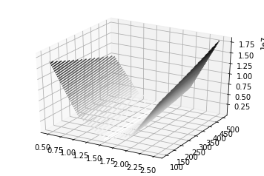
Mathematics of ML: least squares
To make a 3D plot :
import matplotlib.pyplot as pl
import numpy as np
X = np.array( [1000.0, 1300, 1400, 1700,2500])
Y = np.array( [ 2000, 2100, 2500, 2600, 4000])
def func_line(x, a, b):
return a * x + b
def sum_sq(a,b):
s = 0
for i in range(len(X)):
s=s+(a*X[i]+b-Y[i])*(a*X[i]+b-Y[i])
return s
fig=pl.figure()
a = np.array([0.5,1.0,1.5,2.0,2.5])
#b=472
b = np.array([100,200,300,400,500])
A,B=np.meshgrid(a,b)
Z = sum_sq(A,B)
ax=pl.axes(projection='3d')
ax.contour3D(A,B,Z,50,cmap='binary')
i

Slide 47
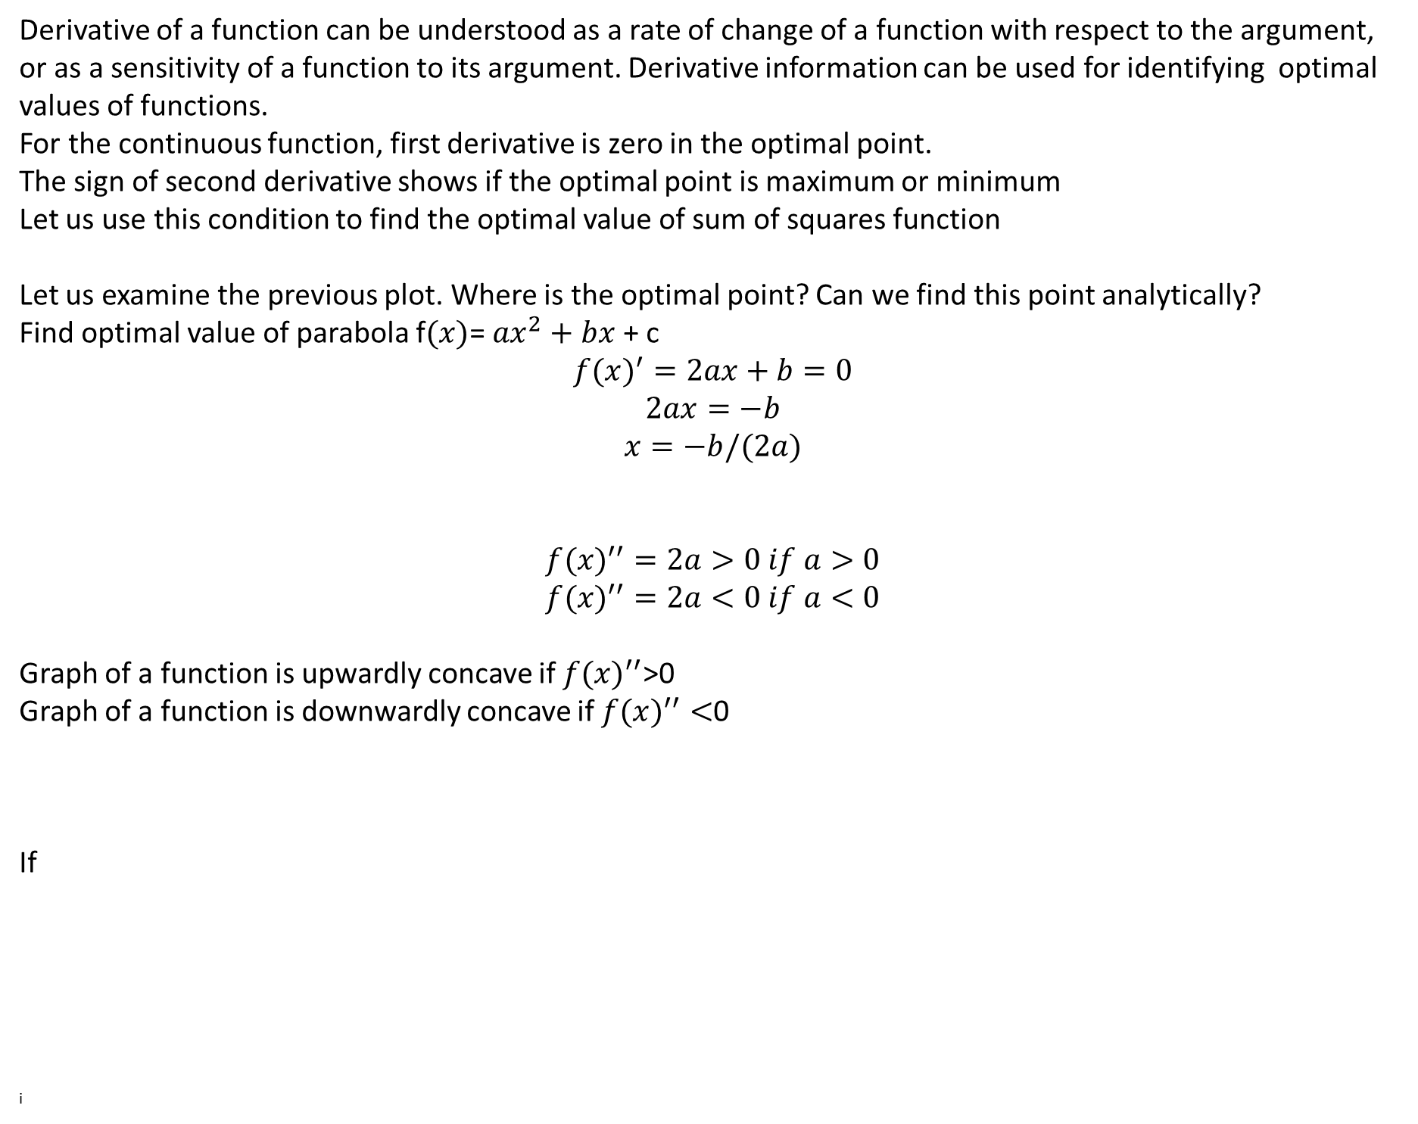
Mathematics of ML: computing derivatives
Derivative of a function can be understood as a rate of change of a function with respect to the argument, or as a sensitivity of a function to its argument. Derivative information can be used for identifying optimal values of functions.
For the continuous function, first derivative is zero in the optimal point.
The sign of second derivative shows if the optimal point is maximum or minimum
Let us use this condition to find the optimal value of sum of squares function
Let us examine the previous plot. Where is the optimal point? Can we find this point analytically?
Find optimal value of parabola f$(x)$= ${ax}^{2}+bx$ + c
$${f(x)}^{′}=2ax+b=0$$
$$2ax=−b$$
$$x=−b/(2a)$$
$${f(x)}^{′′}=2a>0 if a>0$$
$${f(x)}^{′′}=2a<0 if a<0$$
Graph of a function is upwardly concave if ${f(x)}^{′′}$>0
Graph of a function is downwardly concave if ${f(x)}^{′′}<$0
If
i

Slide 48
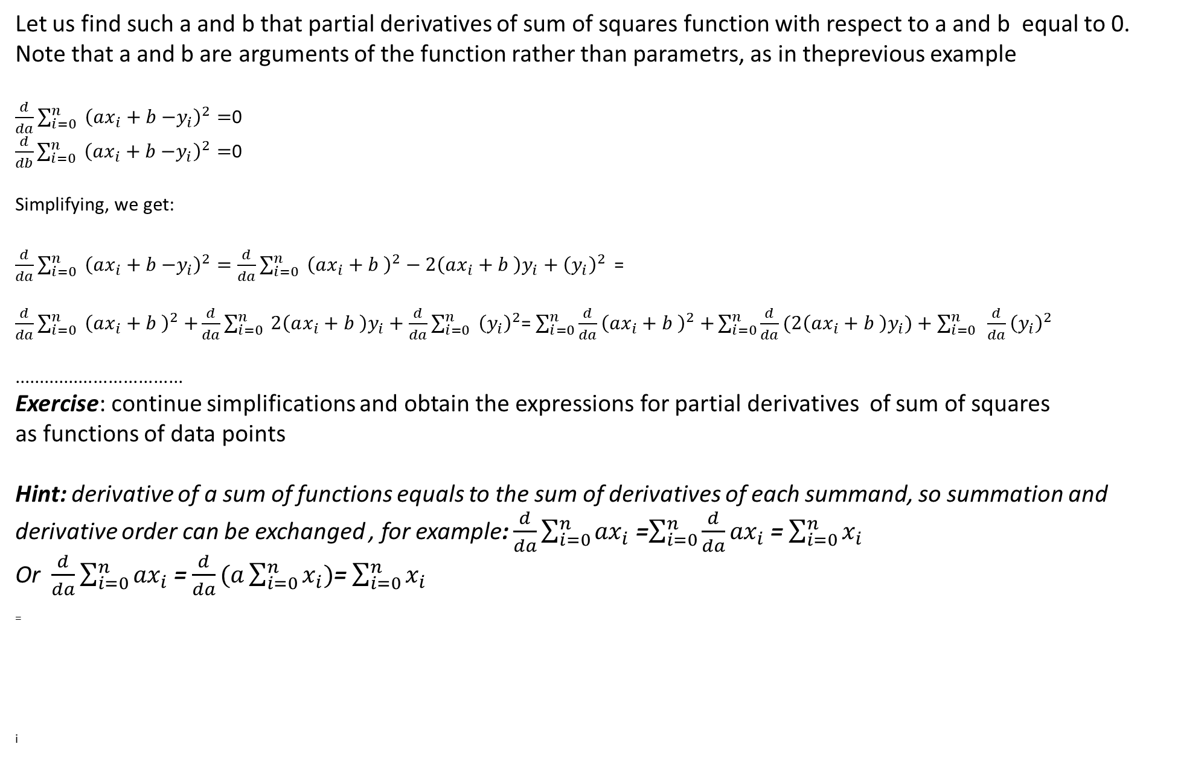
Mathematics of ML: computing derivatives
Let us find such a and b that partial derivatives of sum of squares function with respect to a and b equal to 0.
Note that a and b are arguments of the function rather than parametrs, as in theprevious example
$\frac{d}{da}\sum_{i=0}^{n}{ {\left(ax_{i}+b \text{−}y_{i}\right)}^{2}=}$0
$\frac{d}{db}\sum_{i=0}^{n}{ {\left(ax_{i}+b \text{−}y_{i}\right)}^{2}=}$0
Simplifying, we get:
$\frac{d}{da}\sum_{i=0}^{n}{ {\left(ax_{i}+b \text{−}y_{i}\right)}^{2}=\frac{d}{da}\sum_{i=0}^{n}{ {\left(ax_{i}+b \right)}^{2}−2\left(ax_{i}+b \right)y_{i}+{\left(y_{i}\right)}^{2}} }$=
$\frac{d}{da}\sum_{i=0}^{n}{ {\left(ax_{i}+b \right)}^{2}+}\frac{d}{da}\sum_{i=0}^{n}{ 2\left(ax_{i}+b \right)y_{i}+\frac{d}{da}\sum_{i=0}^{n}{ {\left(y_{i}\right)}^{2}}}$= $\sum_{i=0}^{n}{\frac{d}{da}{\left(ax_{i}+b \right)}^{2}+}\sum_{i=0}^{n}{\frac{d}{da}(2\left(ax_{i}+b \right)y_{i})+\sum_{i=0}^{n}{ {\frac{d}{da}\left(y_{i}\right)}^{2}}}$
..................................
Exercise: continue simplifications and obtain the expressions for partial derivatives of sum of squares
as functions of data points
Hint: derivative of a sum of functions equals to the sum of derivatives of each summand, so summation and derivative order can be exchanged , for example: $\frac{d}{da}\sum_{i=0}^{n}{{ax}_{i}}$ =$\sum_{i=0}^{n}{\frac{d}{da}{ax}_{i}}$ = $\sum_{i=0}^{n}{x_{i}}$
Or $\frac{d}{da}\sum_{i=0}^{n}{{ax}_{i}}$ = $\frac{d}{da}(a\sum_{i=0}^{n}{x_{i})}$= $\sum_{i=0}^{n}{x_{i}}$
=
i

Slide 49
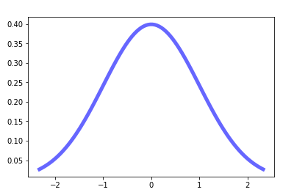
Mathematics of ML: probabilistic modeling
Probabilistic models of data. Why we consider probabilistic models.
One way to deal with uncertainty in mathematical model is to introduce random variables.
Mathematical variable can be deterministic (has a certain value) or stochastic(random)
(taking one of the values from a set of possible values, called a distribution of a random variable)
Distributions can be descrete and continuous.
Examples:
Normal distribution – continuous
Binomial distributio: descrete
Normal distribution is symmetrical and has thin tales.
Example of normal distribution
=
i

Slide 50
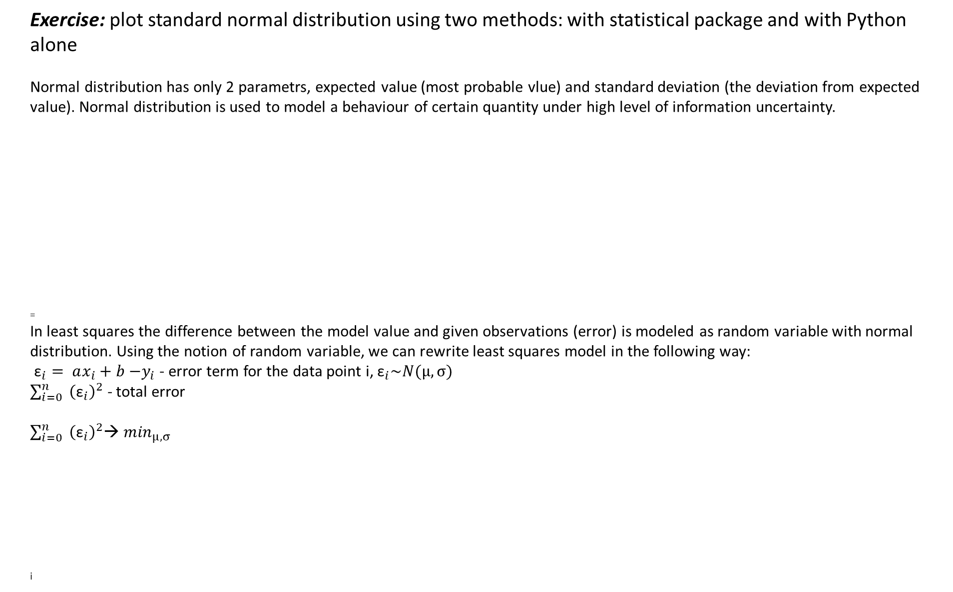
Mathematics of ML: probabilistic modeling
Exercise: plot standard normal distribution using two methods: with statistical package and with Python alone
Normal distribution has only 2 parametrs, expected value (most probable vlue) and standard deviation (the deviation from expected value). Normal distribution is used to model a behaviour of certain quantity under high level of information uncertainty.
=
In least squares the difference between the model value and given observations (error) is modeled as random variable with normal distribution. Using the notion of random variable, we can rewrite least squares model in the following way:
${\text{ε}}_{i}= ax_{i}+b \text{−}y_{i}$ - error term for the data point i, ${\text{ε}}_{i}\sim N(μ,σ)$
$\sum_{i=0}^{n}{ {\left({\text{ε}}_{i}\right)}^{2}}$ - total error
$\sum_{i=0}^{n}{ {\left({\text{ε}}_{i}\right)}^{2}}$→ $\min_{μ,σ}$
i

Slide 51
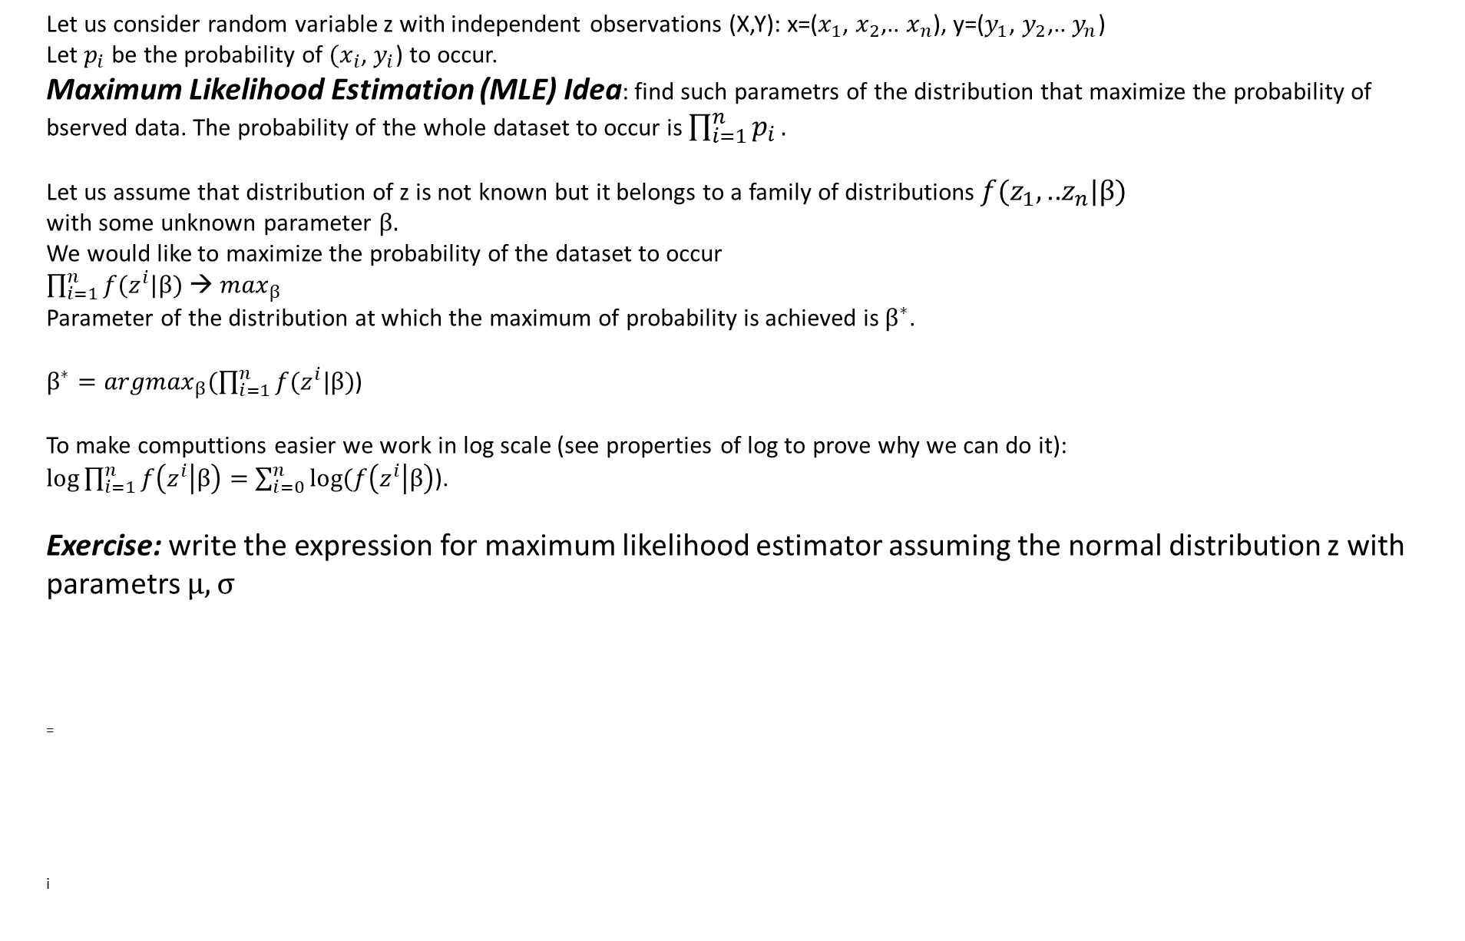
Mathematics of ML: Maximum Likelihood Estimation
Let us consider random variable z with independent observations (X,Y): x=($x_{1}$, $x_{2}$,.. $x_{n}$), y=($y_{1}$, $y_{2}$,.. $y_{n}$)
Let $p_{i}$ be the probability of ${(x}_{i}$, $y_{i}$) to occur.
Maximum Likelihood Estimation (MLE) Idea: find such parametrs of the distribution that maximize the probability of bserved data. The probability of the whole dataset to occur is $\prod_{i=1}^{n}{p_{i}}.$
Let us assume that distribution of z is not known but it belongs to a family of distributions $f(z_{1},\text{..}z_{n}|β)$
with some unknown parameter $β.$
We would like to maximize the probability of the dataset to occur
$\prod_{i=1}^{n}{f(z^{i}|β)}$ → $\max_{β}$
Parameter of the distribution at which the maximum of probability is achieved is $β^{∗}$.
$β^{∗}={argmax}_{β}(\prod_{i=1}^{n}{f(z^{i}|β)}$)
To make computtions easier we work in log scale (see properties of log to prove why we can do it):
$log⁡\prod_{i=1}^{n}{f\left(z^{i} | β\right)=}$ $\sum_{i=0}^{n}{log⁡(f\left(z^{i} | β\right)}$).
Exercise: write the expression for maximum likelihood estimator assuming the normal distribution z with parametrs $μ, σ$
=
i

Slide 52
Mathematics of ML: questions for self study
What python tools can be used to solve a system of linear equations?
What python tools can be used to solve a system of linear inequalities?
What python tools can be used to fit data to a line?
Write line equation in two dimensions
What python tools can be used to plot a line?
What is a method of least squares?
What is linear classification?
=
i

Slide 53
Mathematics of ML: summary of day 1
Mathematical background discussed today is needed to have basic understanding of the following machine learning methods:
Linear regression (sklearn.linear_models.linear_regression)
Support Vector Machines (sklearn.SVM.LinearSVM)
Neural Networks (sklearn.neural_network.MLP)
Logistic regression (sklearn.logistic_regression)
=
i

Slide 54
Mathematics of ML: from linear model to neural net
Preview of next lecture
Example:
Design a bot that grades students on a 2-problem quiz, which is graded on a pass/fail basis.
To pass, a student has to get at least one problem right. These are possible situations.
=
i

Slide 55
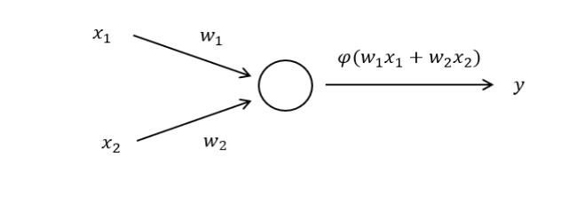
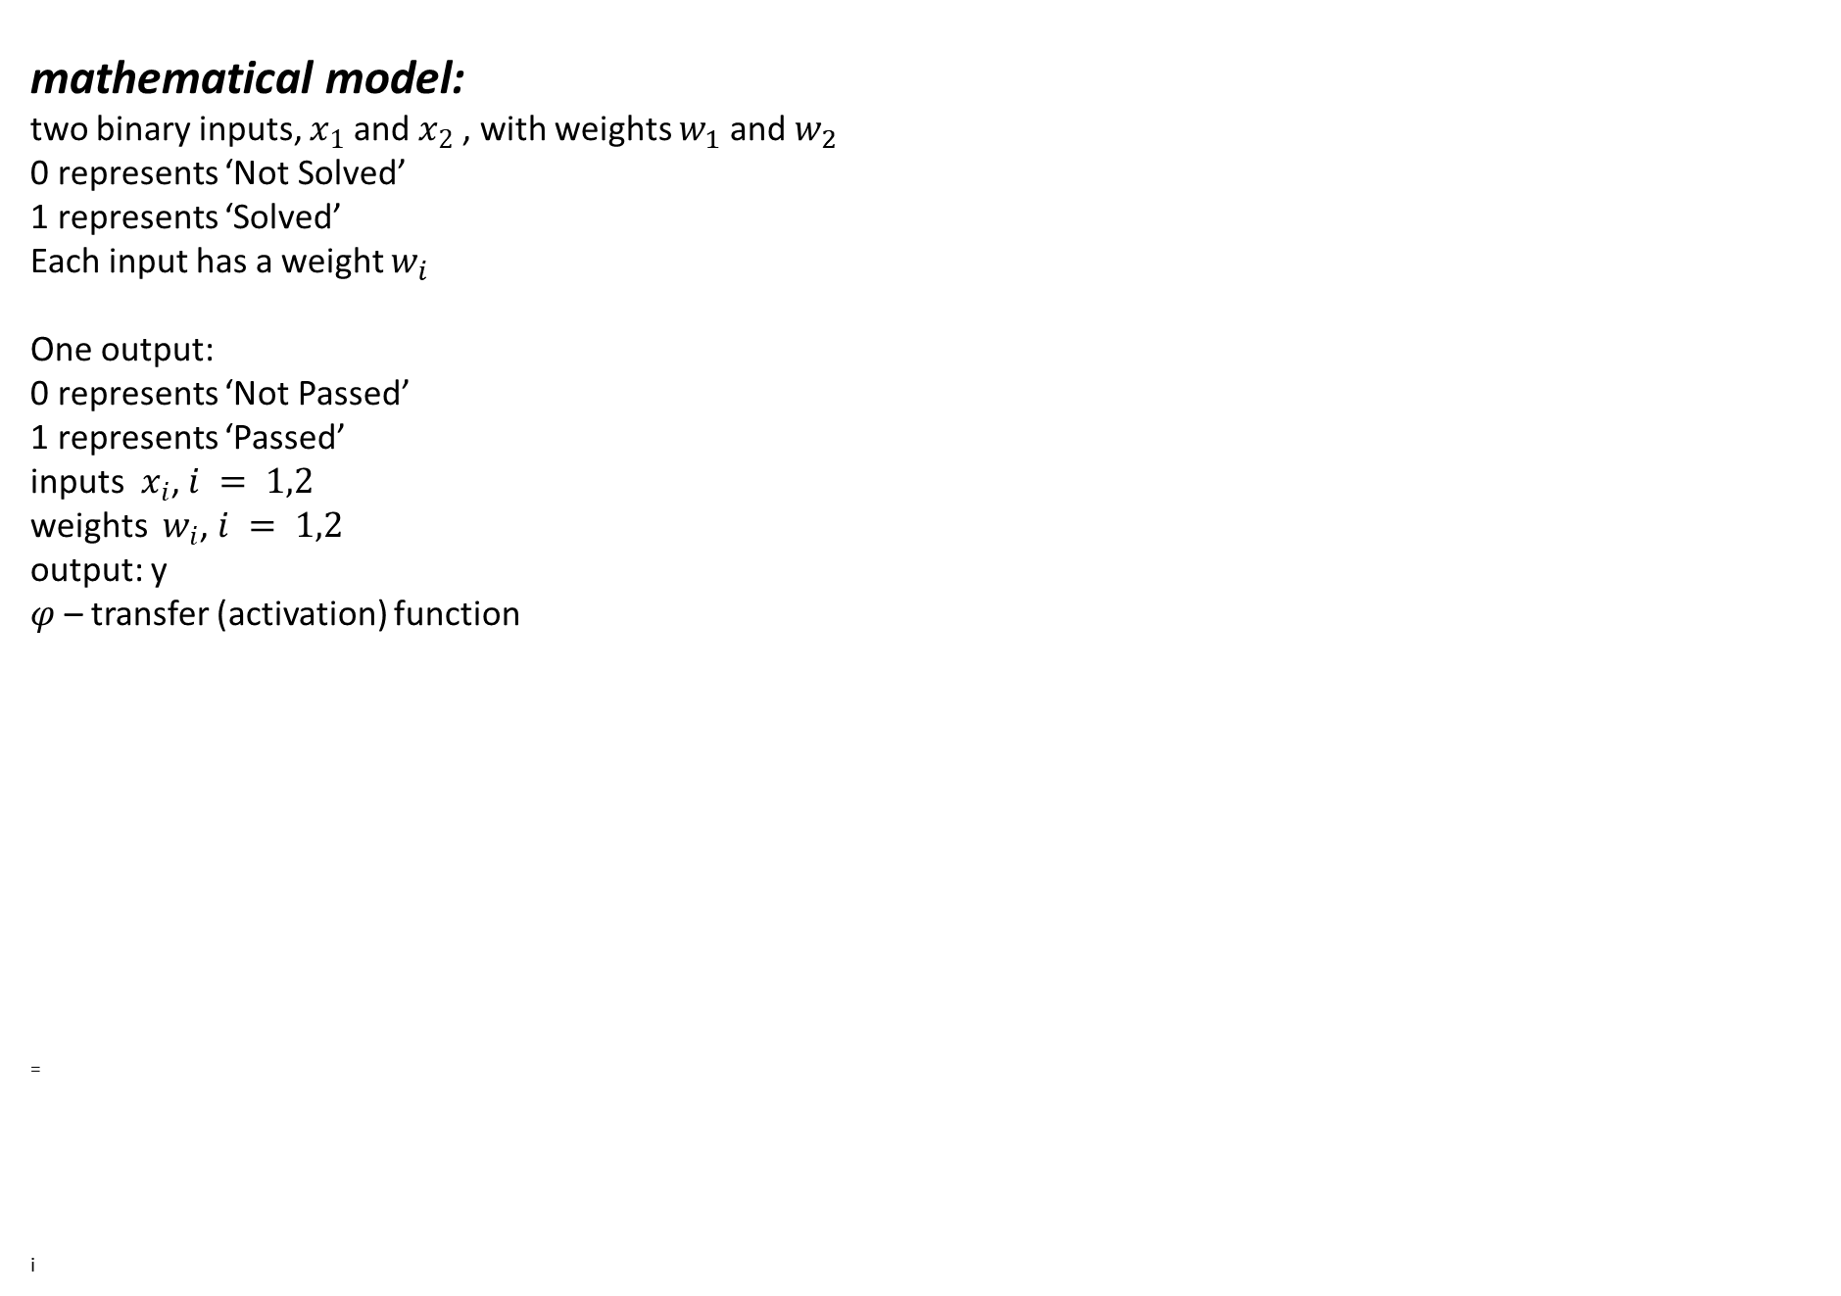
Mathematics of ML: from linear model to neural net
mathematical model:
two binary inputs, $x_{1}$and $x_{2}$ , with weights $w_{1}$ and $w_{2}$
0 represents ‘Not Solved’
1 represents ‘Solved’
Each input has a weight $w_{i}$
One output:
0 represents ‘Not Passed’
1 represents ‘Passed’
inputs $x_{i}$, $i = 1,2$
weights $w_{i}$, $i = 1,2$
output: y
$φ$ – transfer (activation) function
=
i

Slide 56
Mathematics of ML: from linear model to neural net
This is a Python function that represents the “rule” that neural network tries to learn.
def unit_step_function(x):
if x >= 0.5:
return 1
return 0
We know that the rule was learned successfully when all inputs return the correct corresponding output.
This is the code
import numpy as np
def Perceptron(n, in_data, weights=None):
if weights is None:
weights = np.ones(n) * 0.5
weighted_input = weights * in_data
weighted_sum = weighted_input.sum()
return unit_step_function(weighted_sum)
def unit_step_function(x):
if x > 0.5:
return 1
return 0
for x in [np.array([0, 0]), np.array([0, 1]), np.array([1, 0]), np.array([1, 1])]:
y = Perceptron(2, np.array(x))
print(x, y)
Exercise: Suppose a student only earns a Pass if both problems are solved correctly. Make similar model and write Python code that solves the problem
=
i

Slide 57
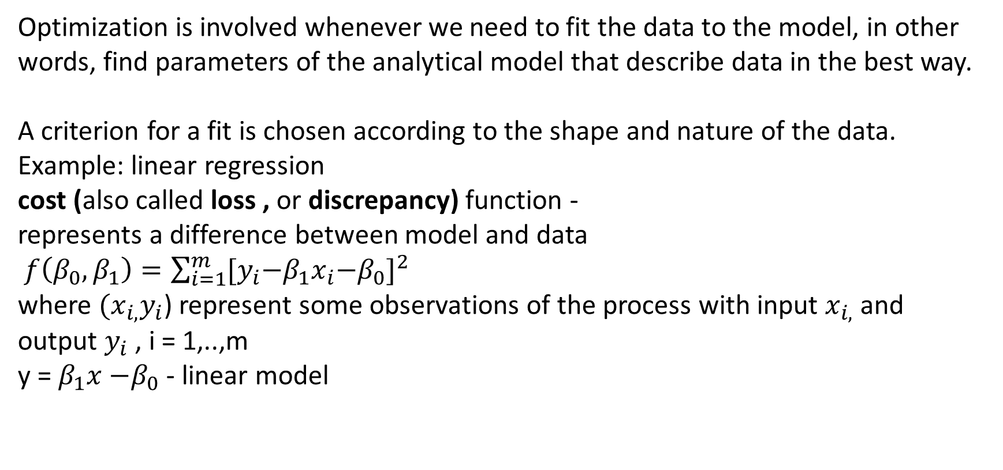
Mathematical optimization for ML
Optimization is involved whenever we need to fit the data to the model, in other words, find parameters of the analytical model that describe data in the best way.
A criterion for a fit is chosen according to the shape and nature of the data.
Example: linear regression
cost (also called loss , or discrepancy) function -
represents a difference between model and data
$f\left({β_{0},β}_{1}\right)=\sum_{i=1}^{m}{{{[y}_{i}−β_{1}x_{i}{−β}_{0}]}^{2}}$
where ${(x}_{i,}y_{i}$) represent some observations of the process with input $x_{i,}$ and output $y_{i}$ , i = 1,..,m
y = $β_{1}x{−β}_{0}$ - linear model

Slide 58
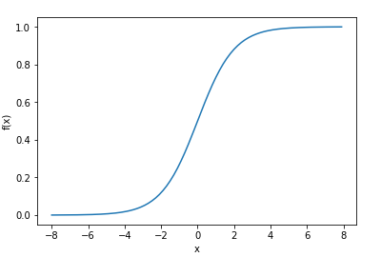
Mathematical optimization for ML
A frequently used model function is a sigmoid function:
This is a python program that makes the above plot:
x = np.arange(-8, 8, 0.1)
f = 1 / (1 + np.exp(-x))
plt.plot(x, f)
plt.xlabel('x')
plt.ylabel('f(x)')
plt.show()

Slide 59
Mathematical optimization for ML
Sigmoid function is a transformation of exponent function shown below
This is a python program that creates a plot:
x = np.linspace(-5,5,100)
f = np.exp(x)
plt.plot(x, f)
plt.xlabel('x')
plt.ylabel('f(x)')
plt.show()

Slide 60
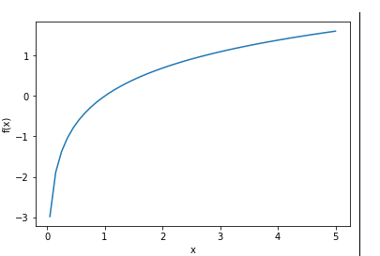
Mathematical optimization for ML
The inverse of exponent is a logarithm function
This is a python program that creates a plot:
x = np.linspace(-5,5,100)
f = np.log(x)
plt.plot(x, f)
plt.xlabel('x')
plt.ylabel('f(x)')
plt.show()

Slide 61
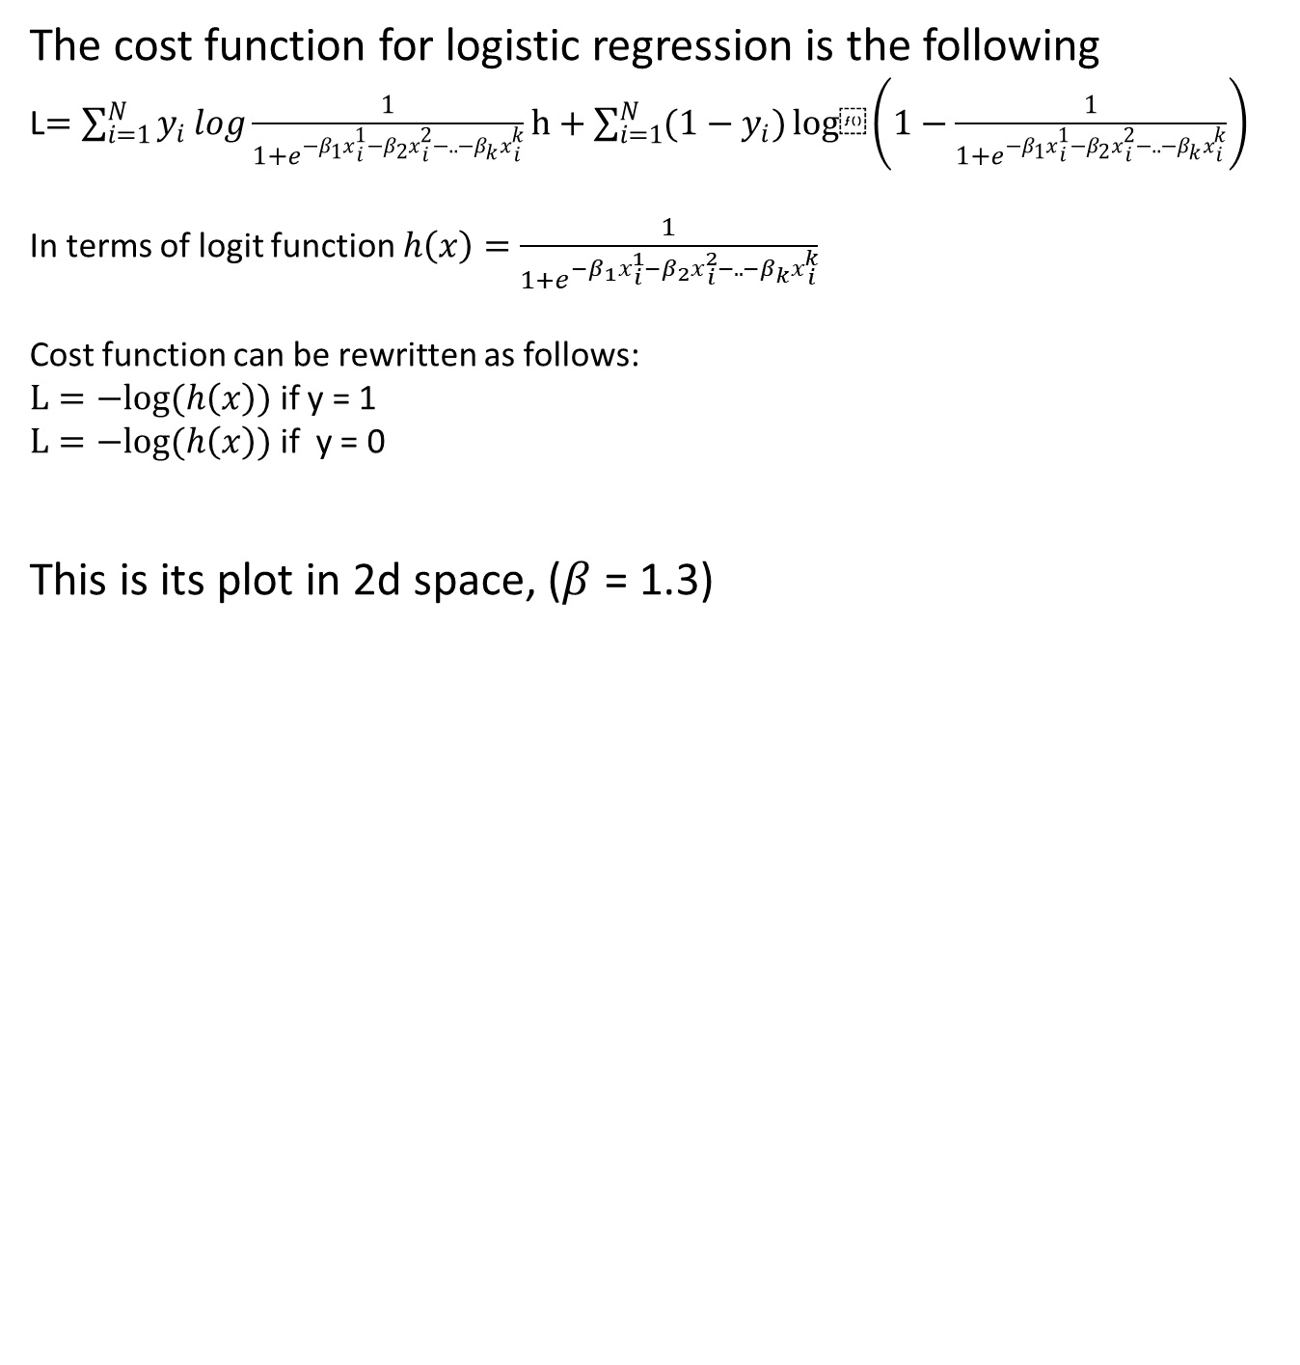
Mathematical optimization for ML
The cost function for logistic regression is the following
L$=\sum_{i=1}^{N}{y_{i}}log\frac{1}{1+e^{{−β}_{1}x{1 \atop i}−β_{2}x{2 \atop i}−..−β_{k}x{k \atop i}}}h+\sum_{i=1}^{N}{{(1−y}_{i})}log⁡\left(1−\frac{1}{1+e^{{−β}_{1}x{1 \atop i}−β_{2}x{2 \atop i}−..−β_{k}x{k \atop i}}}\right)$
In terms of logit function $h\left(x\right)=\frac{1}{1+e^{{−β}_{1}x{1 \atop i}−β_{2}x{2 \atop i}−..−β_{k}x{k \atop i}}}$
Cost function can be rewritten as follows:
$L=−log⁡(h\left(x\right))$ if y = 1
$L=−log⁡(h\left(x\right))$ if y = 0
This is its plot in 2d space, ($β$ = 1.3)

Slide 62
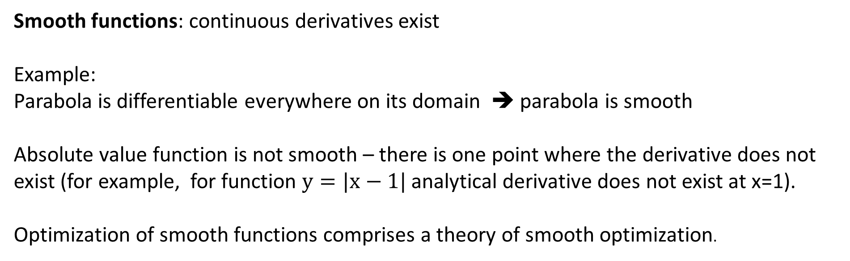
Taxonomy of functions and optimization methods
Smooth functions: continuous derivatives exist
Example:
Parabola is differentiable everywhere on its domain ➔ parabola is smooth
Absolute value function is not smooth – there is one point where the derivative does not exist (for example, for function $y=|x−1|$ analytical derivative does not exist at x=1).
Optimization of smooth functions comprises a theory of smooth optimization.

Slide 63
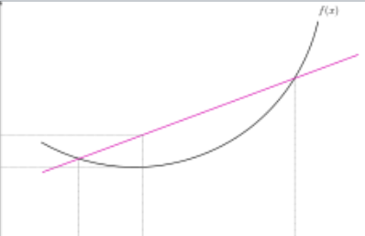
Mathematical optimization
Important subclass - convex functions (pictures – Wikipedia)
If a smooth function is convex it has only one optimal point. According to the Karush-Kuhn-Tucker (KKT) condition to find the optimal value of a smooth convex function it is enough to find a point on the function where its derivative is 0. KKT condition guarantees the existence of an optimal point (not so with non-smooth functions!)
Geometrically, a function is convex if a line segment drawn from any point (x, f(x)) to another point (y, f(y)) -- called the chord from x to y -- lies on or above the graph of f.
A function is concave if -f is convex -- i.e. if the chord from x to y lies on or below the graph of f

Slide 64
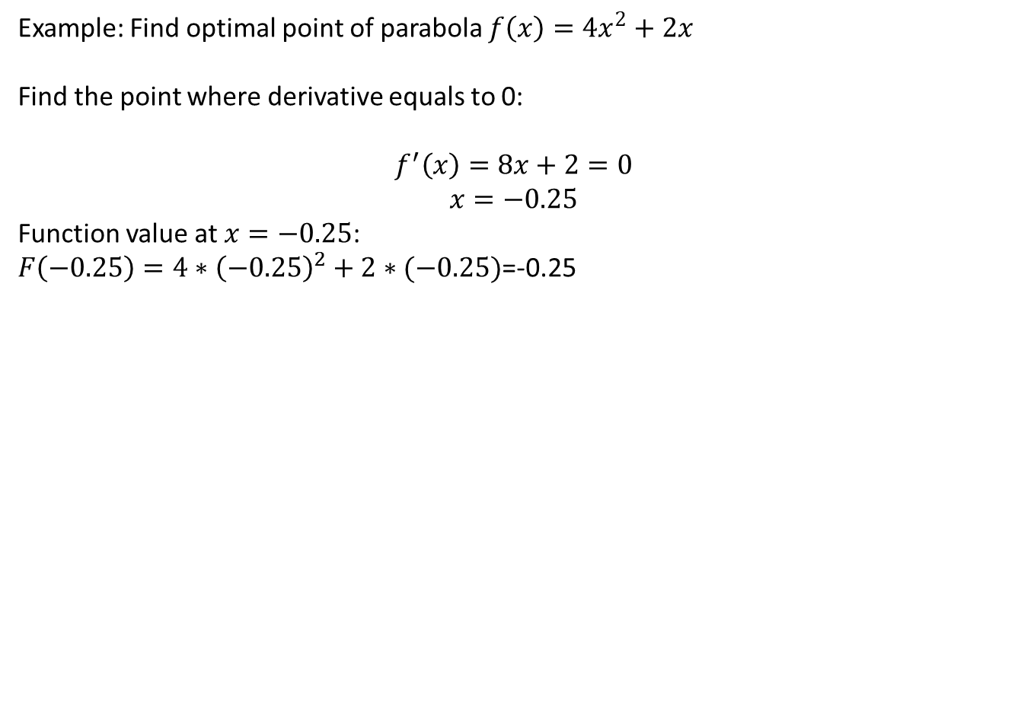
Mathematical optimization
Example: Find optimal point of parabola $f\left(x\right)=4x^{2}+2x$
Find the point where derivative equals to 0:
$$f^{′}\left(x\right)=8x+2=0$$
$$x=−0.25$$
Function value at $x=−0.25$:
$F\left(−0.25\right)=4∗{\left(−0.25\right)}^{2}+2∗(−0.25)$=-0.25

Slide 65
Mathematical optimization
Another way to find optimal point of the function: try to compute function values in different points, in some order, until the best function value is found
Example: Golden section search

Slide 66
Mathematical optimization
Python implementation of Golden Section search
First , make all imports and define constants
import math
import matplotlib.pyplot as plt
from matplotlib.legend_handler import HandlerLine2D
import numpy as np
invphi = (math.sqrt(5) - 1) / 2 # 1/phi
invphi2 = (3 - math.sqrt(5)) / 2 # 1/phi^2
This is a definition of polynomial function
def func( x ):
f = -0.3*x**4 + 1.5*x**3 - 1.9*x**2 + 4.0*x
return f

Slide 67
Mathematical optimization
Golden section function:
def gss(f,a,b,tol=1e-5):
(a,b)=(min(a,b),max(a,b))
h = b - a
if h <= tol: return (a,b)
# required steps to achieve tolerance
n = int(math.ceil(math.log(tol/h)/math.log(invphi)))
c = a + invphi2 * h
d = a + invphi * h
yc = func(c)
yd = func(d)
for k in xrange(n-1):
if yc < yd:
b = d
d = c
yd = yc
h = invphi*h
c = a + invphi2 * h
yc = func(c)
else:
a = c
c = d
yc = yd
h = invphi*h
d = a + invphi * h
yd = f(d)
if yc < yd:
return (a,d)
else:
return (c,b)

Slide 68
Mathematical optimization
Main program
es = 0.1 # Stopping criterion
xL = -2.0 # Initial guesses
xR = 4.0
# Call GS method
xopt = GS(xL, xR, es)
# Plot equation to check GSS
i = 0
x = np.linspace(-2,4, 1000)
f = np.linspace(0, 0,len(x))
for i in range(0, len(x), 1):
f[i] = func(x[i])
p1, = plt.plot(x, f, '--', label='f(x)')
p2, = plt.plot(xopt, func(xopt),'bo',
label='max[f(x)]', markersize=10, markeredgewidth=3)
plt.title('Finding max[f(x)] Using Golden-Section Search')
plt.xlabel('x')
plt.ylabel('f(x)')
plt.legend(loc='best',
handler_map={p2: HandlerLine2D(numpoints=1)})
plt.grid(True)
plt.show()

Slide 69
Mathematical optimization
A non-convex function "curves up and down" -- it is neither convex nor concave.
Example1: sine function
note that this function is convex from -pi to 0, and concave from 0 to +pi. If the bounds on the variables restrict the domain of the objective and constraints to a region where the functions are convex, then the overall problem is convex.
Example2: Eggholder function in 3d space

Slide 70
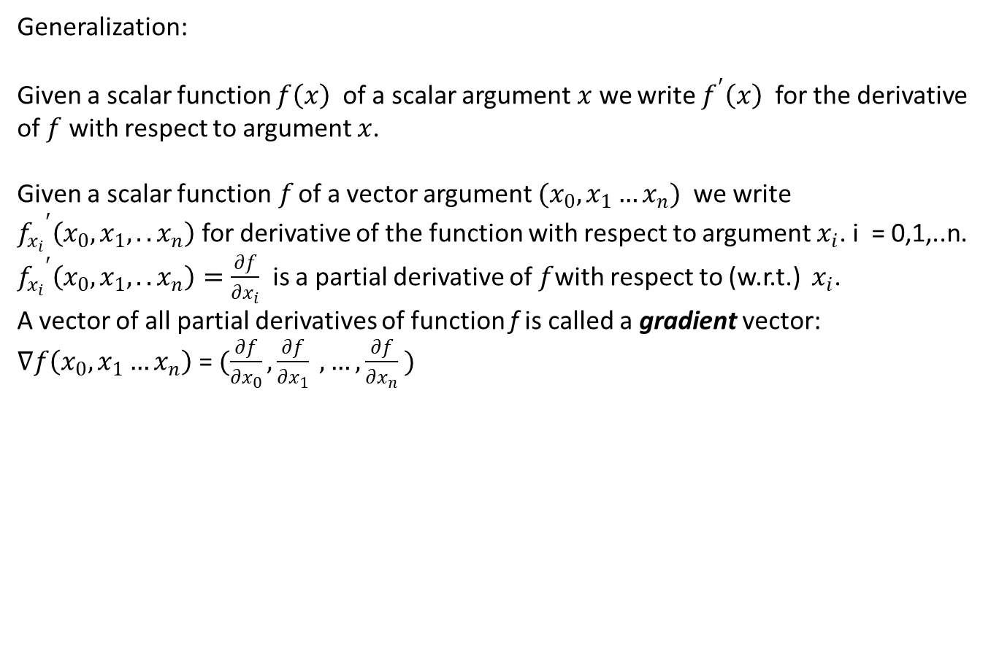
Mathematical optimization
Generalization:
Given a scalar function $f\left(x\right)$ of a scalar argument$x$we write $f^{′}\left(x\right)$ for the derivative of $f$ with respect to argument $x$.
Given a scalar function$f$ of a vector argument ${(x}_{0}, x_{1}…x_{n})$we write ${f_{x_{i}}}^{′}\left({x_{0},x}_{1}, ..x_{n}\right)$for derivative of the function with respect to argument $x_{i}$. i = 0,1,..n.
${f_{x_{i}}}^{′}\left({x_{0},x}_{1}, ..x_{n}\right)=\frac{∂f}{∂x_{i}}$ is a partial derivative of $f$with respect to (w.r.t.) $x_{i}$.
A vector of all partial derivatives of function f is called a gradient vector:
$∇f\left(x_{0}, x_{1}…x_{n}\right)$ = $(\frac{∂f}{∂x_{0}}, \frac{∂f}{∂x_{1}} ,…,\frac{∂f}{∂x_{n}} )$

Slide 71
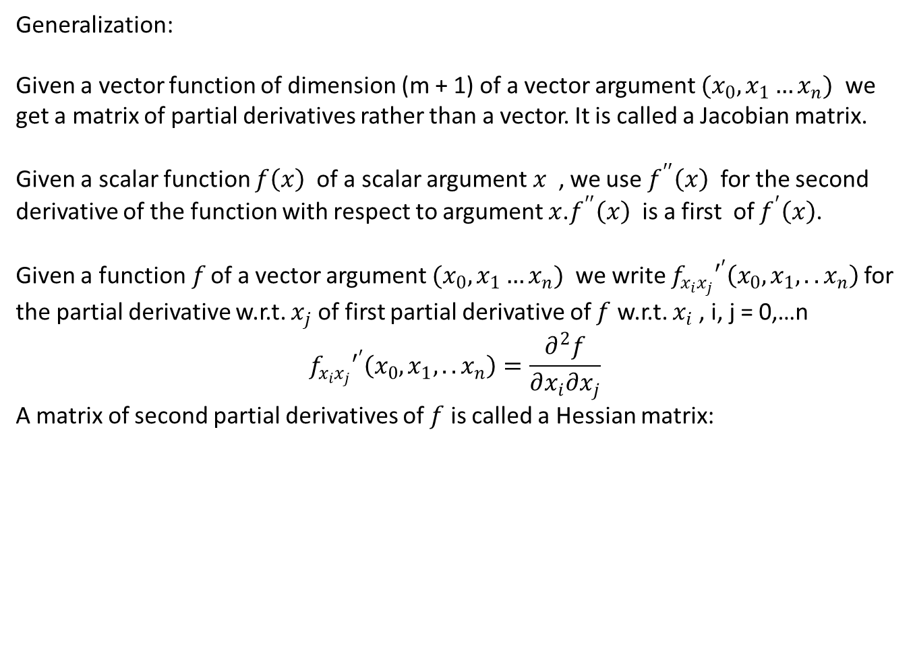
Mathematical optimization
Generalization:
Given a vector function of dimension (m + 1) of a vector argument ${(x}_{0}, x_{1}…x_{n})$ we get a matrix of partial derivatives rather than a vector. It is called a Jacobian matrix.
Given a scalar function $f\left(x\right)$ of a scalar argument$x$, we use $f^{′′}\left(x\right)$ for the second derivative of the function with respect to argument $x$.$f^{′′}\left(x\right)$ is a first of $f^{′}\left(x\right)$.
Given a function$f$ of a vector argument ${(x}_{0}, x_{1}…x_{n})$we write ${f_{x_{i}x_{j}}′}^{′}\left({x_{0},x}_{1}, ..x_{n}\right)$for the partial derivative w.r.t. $x_{j}$of first partial derivative of $f$ w.r.t. $x_{i}$, i, j = 0,…n
$${f_{x_{i}x_{j}}′}^{′}\left({x_{0},x}_{1}, ..x_{n}\right)=\frac{∂^{2}f}{∂x_{i}∂x_{j}}$$
A matrix of second partial derivatives of $f$ is called a Hessian matrix:

Slide 72
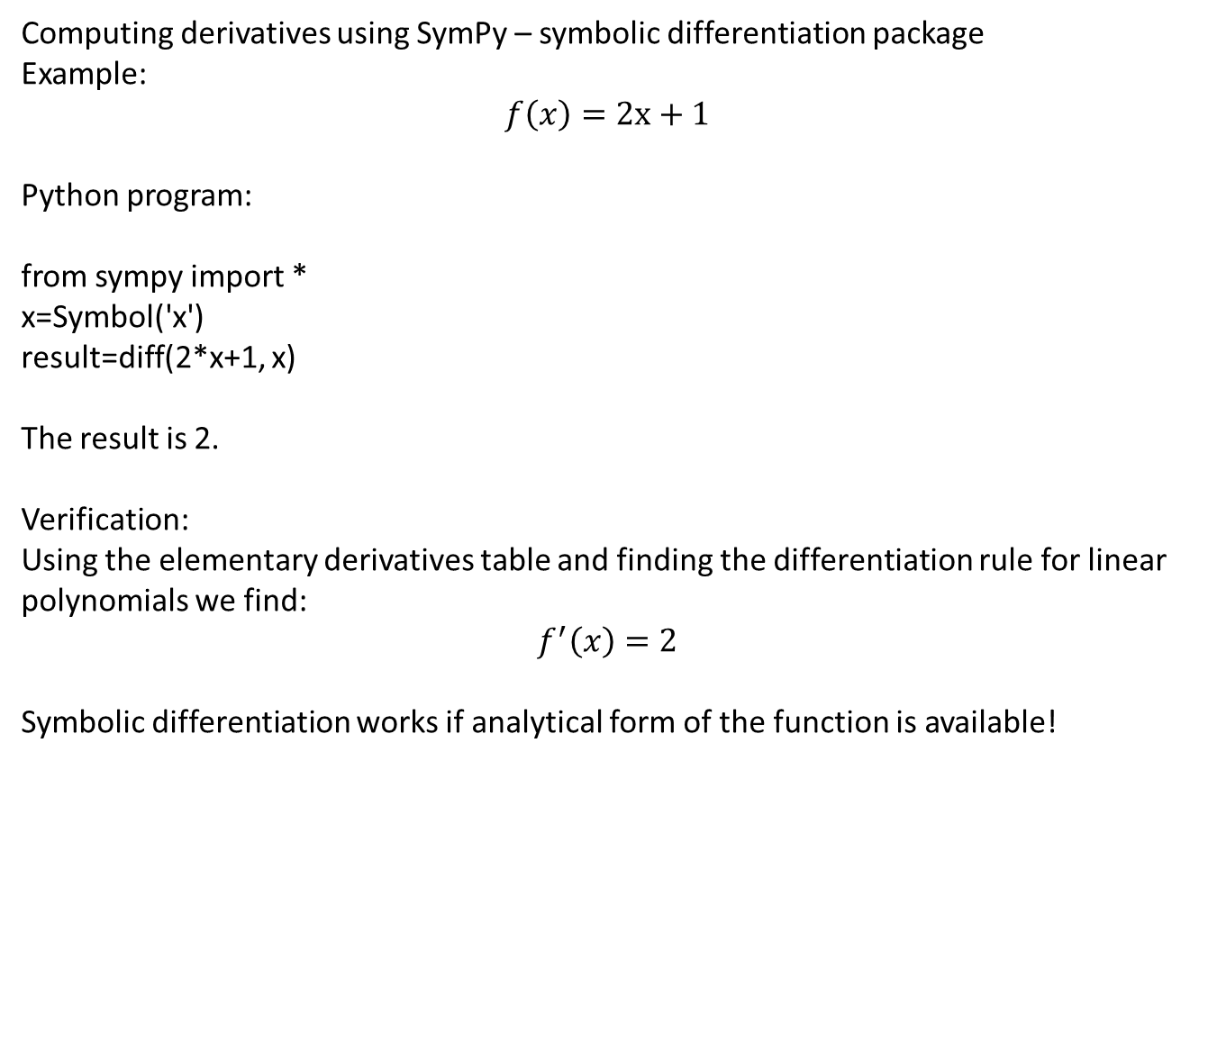
Mathematical optimization
Computing derivatives using SymPy – symbolic differentiation package
Example:
$$f\left(x\right)=2x+1$$
Python program:
from sympy import *
x=Symbol('x')
result=diff(2*x+1, x)
The result is 2.
Verification:
Using the elementary derivatives table and finding the differentiation rule for linear polynomials we find:
$$f^{′}\left(x\right)=2$$
Symbolic differentiation works if analytical form of the function is available!

Slide 73
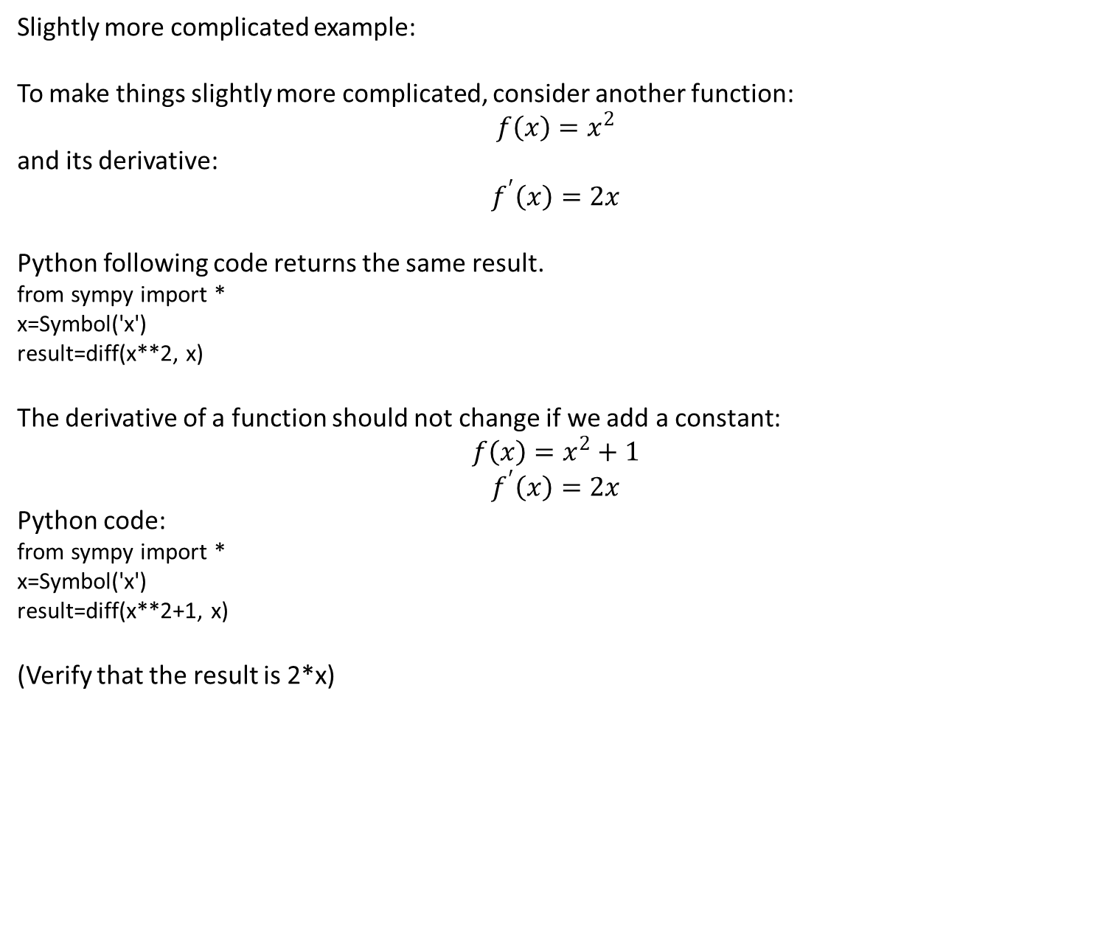
Mathematical optimization
Slightly more complicated example:
To make things slightly more complicated, consider another function:
$$f\left(x\right)=x^{2}$$
and its derivative:
$$f^{′}\left(x\right)=2x$$
Python following code returns the same result.
from sympy import *
x=Symbol('x')
result=diff(x**2, x)
The derivative of a function should not change if we add a constant:
$$f\left(x\right)=x^{2}+1$$
$$f^{′}\left(x\right)=2x$$
Python code:
from sympy import *
x=Symbol('x')
result=diff(x**2+1, x)
(Verify that the result is 2*x)

Slide 74

Mathematical optimization
If a function has several optima, then the minimum of all minimum points is called the global minimum, and the maximum of all maximum points is called the global maximum. Other optimal points are called local optimal points.
Example: Ackley function – global minimum at f(0,0)=0

Slide 75

Mathematical optimization
Very often in practice we deal with complicated functions of many arguments with unknown landscapes. In this case, instead of finding optimal points of the functions analytically (finding roots of derivatives) iterative optimization algorithms are used. Starting from an initial point they make steps towards the (presumed) optimal point.
This is what optimization procedure looks like:
$$X^{q}=X^{q−1}+α^{q}S^{q}$$
where $q$ is the iteration counter, $S^{q}$ is a search direction on iteration$q$ , $α^{q}$ is a step size on iteration$q$, and $X^{0}$ is the starting point of the search.
According to the preceding rule the optimization procedure can be defined by two parameters: search direction (S) and step size (α). Search direction is determined according to some criteria. For a smooth function the gradient information can be used to determine a search direction.
Example: gradient descent algorithm

Slide 76

Mathematical optimization
Example: gradient descent algorithm
We consider an optimization method that uses the gradient of the function as well as
the function values.
The greatest local increase in the function for a given small step h occurs when d is
in the direction of $∇f\left(x\right)$ So the direction of steepest descent is in the direction
$−∇f\left(x\right)$
$$df=\left|∇f\left(x\right)\right|\left|dx\right|cosθ$$
where $θ$ is the angle between $∇f\left(x\right)$ and $dx$ . For a given magnitude of $dx$ we
minimize $df$ by choosing $θ$ to be 180° so that $dx$ is in the direction $−∇f\left(x\right).$
The gradient direction is orthogonal to the contours of the function at any point, for on a contour the function value does not change. Thus if $\left(d_{1},d_{2},…,d_{n}\right)$ is a small step along the contour, then
$f\left(x_{1}+d_{1},x_{2}+d_{2}, {…x}_{n}+d_{n}\right)=f(x_{1},x_{2},$…,$x_{n})$
$df=\sum_{j=1}^{n}{\frac{∂f}{∂x_{j}}}d_{j}={\left[∇f\left(x\right)\right]}^{T} d=0$

Slide 77

Mathematical optimization
The method of steepest descent seeks to exploit this property of the gradient direction. If we are at the point $x_{i}$ at any stage of the process we search for the function minimum along the direction $−∇f\left(x_{i}\right)$. The method is an iterative process. At stage i we have an approximation $x_{i}$ for the minimum point. Our next approximation is
$x_{i+1}=x_{i}−λ_{i}∇f\left(x_{i}\right)$
where $λ_{i}$ is the value of $λ$ that minimizes
$∅\left(λ\right)=f\left[x_{i}−λ_{i}∇f\left(x_{i}\right)\right]$
$λ_{i}$ can be found by using one of the univariate searches such as the golden section search.

Slide 78







Mathematical optimization
Flowchart of gradient descent method
Start with ${ x}_{i} (i=0)$
Set $d_{i}=−∇f\left(x_{i}\right)$
Find $λ_{i}$ to minimize $f(x_{i}+λd_{i})$
Set $i=i+1)$
Set $x_{i+1}=x_{i}+λ_{i}d_{i}$
No
is $x_{i+1}$ the optimum?
Yes
Set ${x^{∗}=x}_{i+1}$
Stop

Slide 79
Mathematical optimization
Further classification of optimization methods
Zero order methods – use objective function values only
First-order methods – use objective function values and first derivatives of objective function
Second order methods – use objective function values and second derivatives of objective funtion

Slide 80
Mathematical optimization
Heuristic methods – use objective function values only
These methods are used to optimize non-smooth non convex functions. It is not guaranteed that the optimal point is found. Rather, given possible solution, these methods improve it.
Examples:Genetic algorithms, Particle Swarm Optimization, Ant Colony Optimization, Tabu Search, Random search, Covariance Matrix Adaptation Evolution Strategy,
Differential Evolution, Simulated Annealing

Slide 81
Mathematical optimization
One type of heuristic methods for optimization – evolutionary algorithm
Evolutionary algorithms are iterative optimization methods. Evolutionary algorithms resemble evolution processes in nature. These algorithms are population-based algorithms. This means that the search process starts with a set of points (individuals) usually generated randomly. This is an initial population of individuals. On each iteration a fitting values of all individuals are computed. Fitness function is indeed an objective function for optimization. According to certain rules of selection the individuals for the next generation are produced. Rules of selection ae different in each evolutionary algorithm and very often are defined in terms of this special process.

Slide 82

Mathematical optimization
Genetic Algorithm
rules of selection are defined using terminology of genetics:
individuals are represented by genes, and each gene is a collection of chromosomes. Rules of crossover and mutation in genetics become rules of selecting points for the next iteration of the algorithm.
This is an example of genetic rules:

Slide 83
Estimating the performance of ML methods
Supervised methods:
Divide the dataset into training set and testing set
Train the model with training data
Check the performance on the test data

Slide 84

Estimating the performance of ML methods
Divide data into training and testing set.
sklearn.model_selection.train_test_split(*arrays, test_size=None, train_size=None, random_state=None, shuffle=True, stratify=None)[source]¶

Slide 85

Estimating the performance of ML methods
Metrics and scoring: quantifying the quality of predictions
3.3. Metrics and scoring: quantifying the quality of predictions — scikit-learn 0.24.2 documentation
Regression - R² score, the coefficient of determination
Classification – confusion matrix

Slide 86
Estimating the performance of ML methods
Unsupervised methods – no labels:

